Slide 1
15-780 – Graduate Artificial Intelligence:
Probabilistic modeling
Aditi Raghunathan
Carnegie Mellon University
Spring 2023

Slide 2
Outline
Probability in AI
Background
Maximum likelihood estimation

Slide 3
Outline
Probability in AI
Background on probability
Common distributions
Maximum likelihood estimation

Slide 4
Probability in AI
Basic idea: the real world is probabilistic (at least at the level we can observe it), and our reasoning about it needs to be too
The shift from “logical” to “probabilistic” AI systems (circa 80s, 90s) represented a revolution in AI
Probabilistic approaches are now intertwined with virtually all areas of AI, though research e.g. in “pure” probabilistic graphical models has declined a bit in recent years in favor of neural-network-based generative models

Slide 5
Example: topic modeling
Can we learn about the content of text documents just be reading through them and see what sorts of words “co-occur”
Figure from (Blei et al., 2011) demonstrates words and topics recovered from reading 17,000 Science articles

Slide 6
Example: biological networks
Can we automatically determine how the presence or absence of some proteins in a cell affect others?
Figure from (Sachs et al., 2005) shows automatically inferred protein probability network, which captured most of the known interactions using data-driven methods (far less manual effort than previous methods)

Slide 7
Outline
Probability in AI
Background
Maximum likelihood estimation

Slide 8
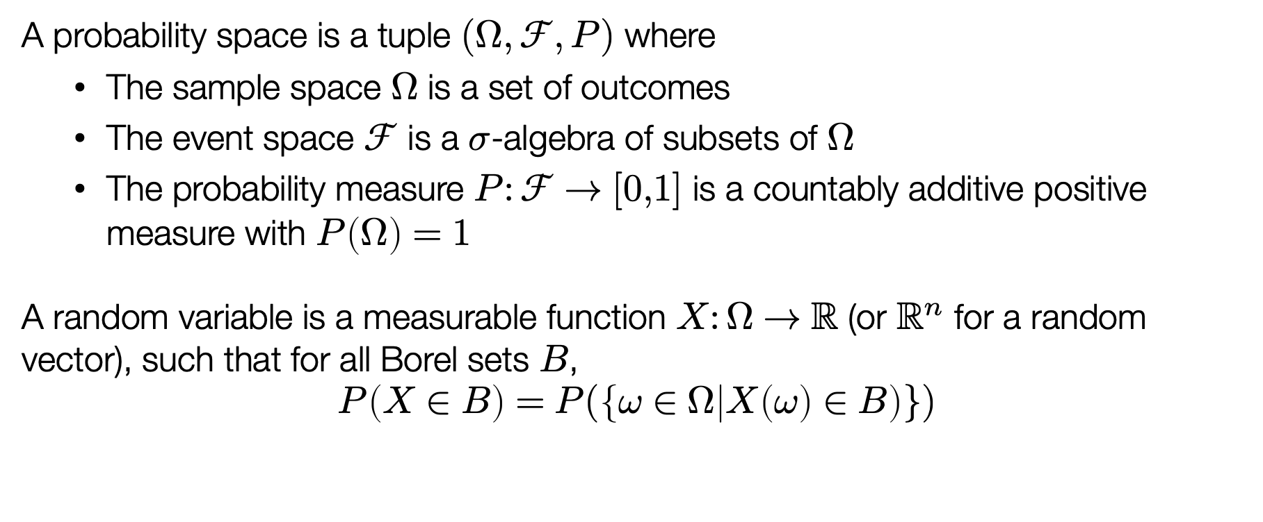
Basics of probability
A probability space is a tuple $(Ω,ℱ,P)$ where
  The sample space $Ω$ is a set of outcomes
  The event space $ℱ$ is a $σ$-algebra of subsets of $Ω$
  The probability measure $P:ℱ→[0,1]$ is a countably additive positive measure with $P\left(Ω\right)=1$
A random variable is a measurable function $X:Ω→ℝ$ (or $ℝ^{n}$ for a random vector), such that for all Borel sets $B$,
$$P\left(X∈B\right)=P(\left\{ω∈Ω | X\left(ω\right)∈B\right)\})$$

Slide 9
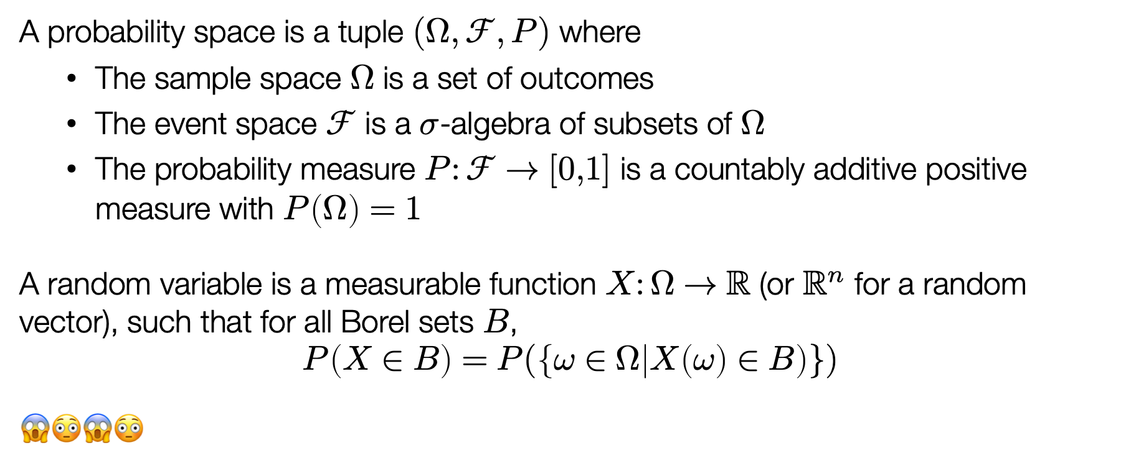
Basics of probability
A probability space is a tuple $(Ω,ℱ,P)$ where
  The sample space $Ω$ is a set of outcomes
  The event space $ℱ$ is a $σ$-algebra of subsets of $Ω$
  The probability measure $P:ℱ→[0,1]$ is a countably additive positive measure with $P\left(Ω\right)=1$
A random variable is a measurable function $X:Ω→ℝ$ (or $ℝ^{n}$ for a random vector), such that for all Borel sets $B$,
$$P\left(X∈B\right)=P(\left\{ω∈Ω | X\left(ω\right)∈B\right)\})$$
😱😳😱😳

Slide 10
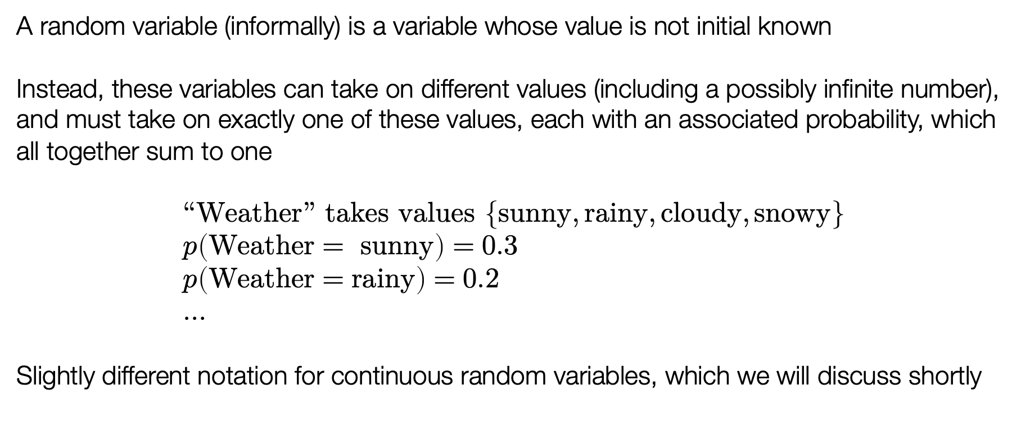
Random variables
A random variable (informally) is a variable whose value is not initial known
Instead, these variables can take on different values (including a possibly infinite number), and must take on exactly one of these values, each with an associated probability, which all together sum to one
$$“Weather” takes values \left\{sunny, rainy,cloudy, snowy\right\} \\ p\left(Weather= sunny\right)=0.3 \\ p\left(Weather=rainy\right)=0.2 \\ …$$
Slightly different notation for continuous random variables, which we will discuss shortly

Slide 11
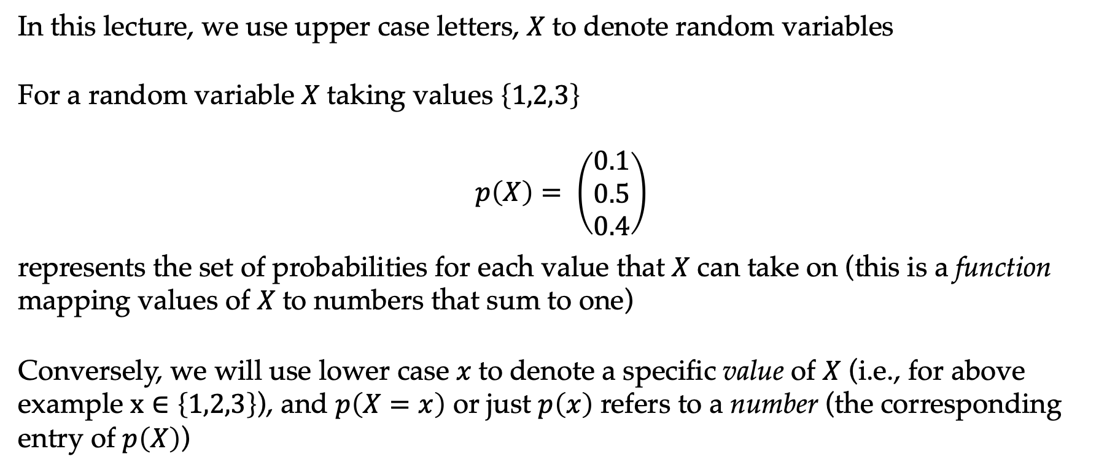
Notation for random variables
In this lecture, we use upper case letters, $X$to denote random variables
For a random variable $X$taking values $\left\{1,2,3\right\}$
$$p\left(X\right)= \left(\begin{matrix}0.1 \\ 0.5 \\ 0.4\end{matrix}\right)$$
represents the set of probabilities for each value that $X$can take on (this is a function mapping values of $X$to numbers that sum to one)
Conversely, we will use lower case $x$to denote a specific value of $X$ (i.e., for above example $x∈\left\{1,2,3\right\}$), and $p\left(X=x\right)$ or just $p\left(x\right)$ refers to a number (the corresponding entry of $p\left(X\right)$)

Slide 12
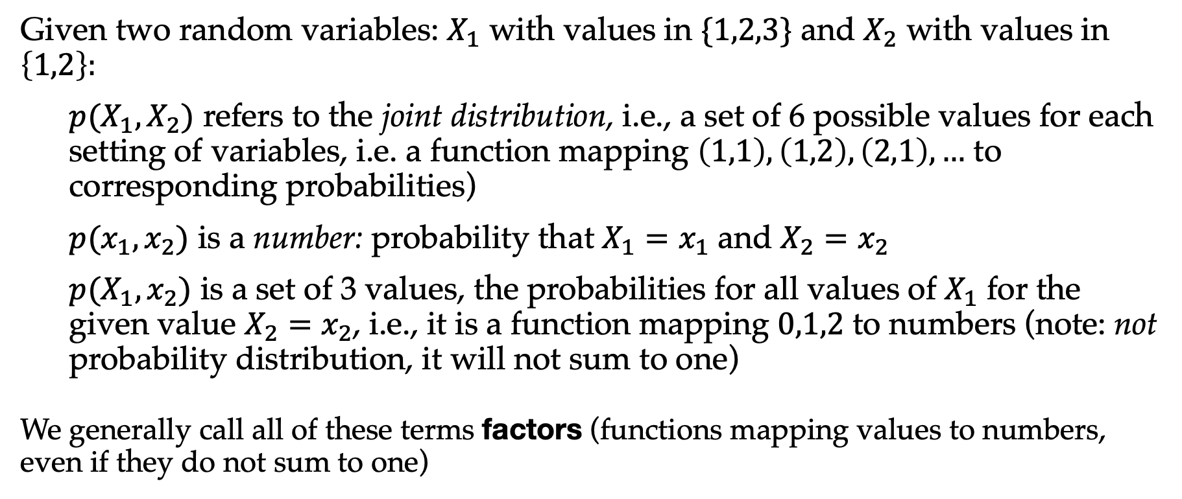
Examples of probability notation
Given two random variables: $X_{1}$ with values in $\{1,2,3\}$ and $X_{2}$ with values in $\left\{1,2\right\}:$
  $p(X_{1},X_{2})$ refers to the joint distribution, i.e., a set of 6 possible values for each setting of variables, i.e. a function mapping $\left(1,1\right), \left(1,2\right),\left(2,1\right),…$ to corresponding probabilities)
  $p(x_{1},x_{2})$ is a number: probability that $X_{1}=x_{1}$ and $X_{2}=x_{2}$
  $p(X_{1},x_{2})$ is a set of 3 values, the probabilities for all values of $X_{1}$ for the given value $X_{2}=x_{2}$, i.e., it is a function mapping $0,1,2$ to numbers (note: not probability distribution, it will not sum to one)
We generally call all of these terms factors (functions mapping values to numbers, even if they do not sum to one)

Slide 13
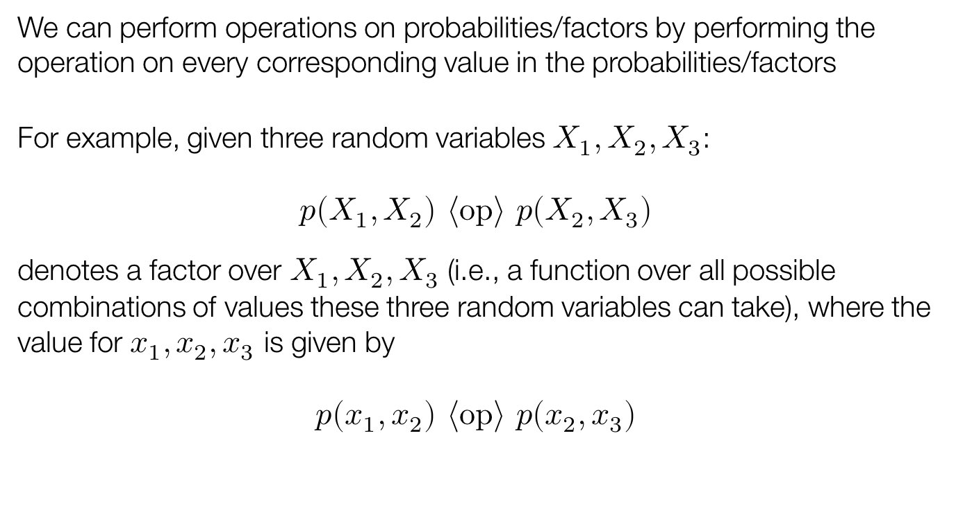
Operations on probabilities/factors
We can perform operations on probabilities/factors by performing the operation on every corresponding value in the probabilities/factors
For example, given three random variables $X_{1},X_{2},X_{3}$:
$$p\left(X_{1},X_{2}\right) \left\langle op\right\rangle p\left(X_{2},X_{3}\right)$$
denotes a factor over $X_{1},X_{2},X_{3}$ (i.e., a function over all possible combinations of values these three random variables can take), where the value for $x_{1}, x_{2},x_{3}$ is given by
$$p\left(x_{1},x_{2}\right) \left\langle op\right\rangle p\left(x_{2},x_{3}\right)$$

Slide 14
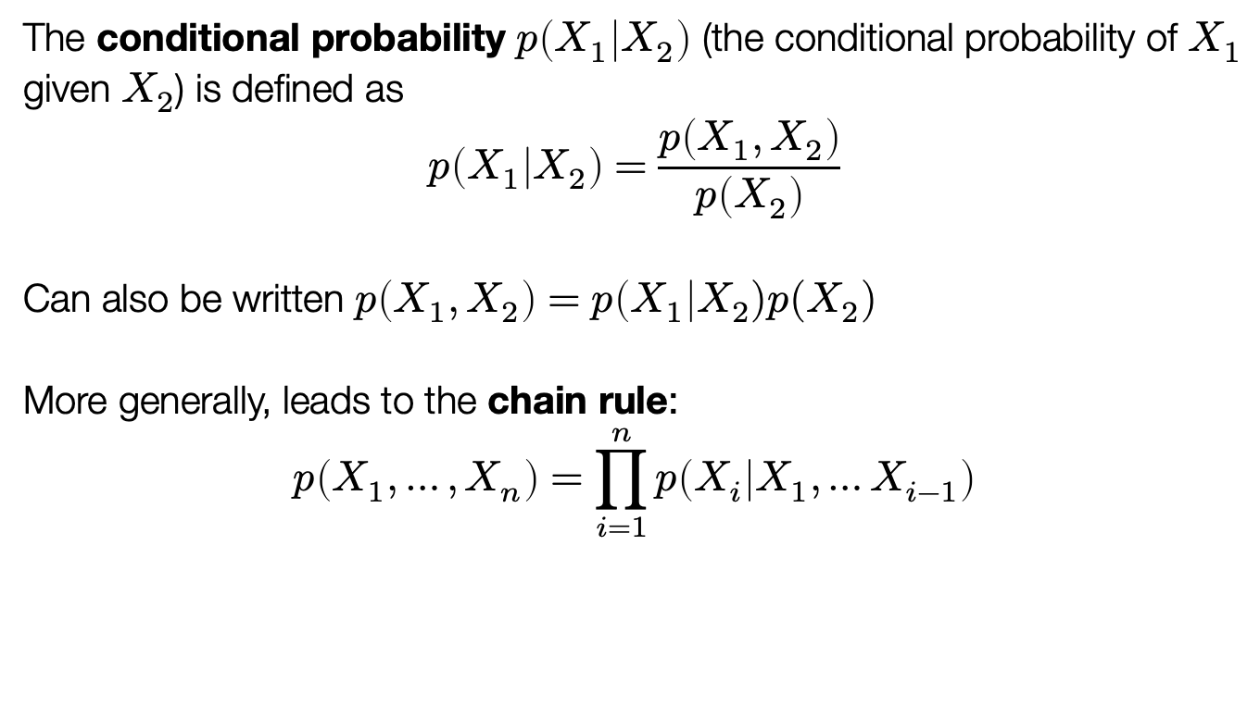
Conditional probability
The conditional probability $p\left(X_{1} | X_{2}\right)$ (the conditional probability of $X_{1}$ given $X_{2}$) is defined as
$$p\left(X_{1} | X_{2}\right)=\frac{p\left(X_{1},X_{2}\right)}{p\left(X_{2}\right)}$$
Can also be written $p\left(X_{1},X_{2}\right)=p\left(X_{1}\right|X_{2})p(X_{2})$
More generally, leads to the chain rule:
$$p\left(X_{1},…,X_{n}\right)=\prod_{i=1}^{n}{p\left(X_{i} | X_{1},…X_{i−1}\right)}$$

Slide 15
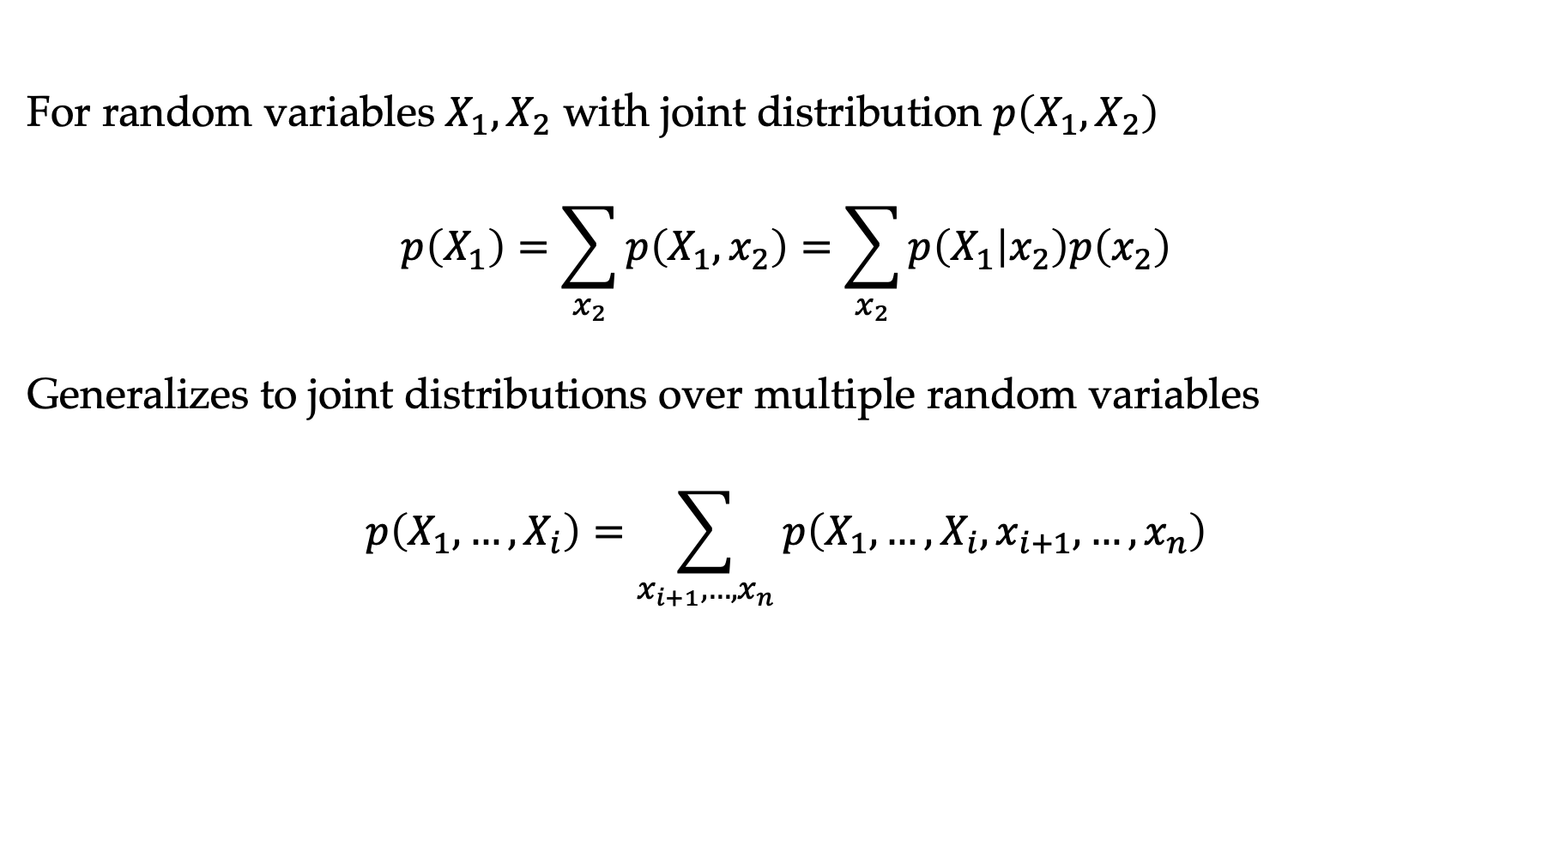
Marginalization
For random variables $X_{1},X_{2}$ with joint distribution $p\left(X_{1},X_{2}\right)$
$$p\left(X_{1}\right)=\sum_{x_{2}}{p\left(X_{1},x_{2}\right)}=\sum_{x_{2}}{p\left(X_{1} | x_{2}\right)p\left(x_{2}\right)}$$
Generalizes to joint distributions over multiple random variables
$$p\left(X_{1},…,X_{i}\right)=\sum_{x_{i+1},…,x_{n}}{p\left(X_{1},…, X_{i},x_{i+1},…, x_{n}\right)}$$

Slide 16
Simple example

Slide 17
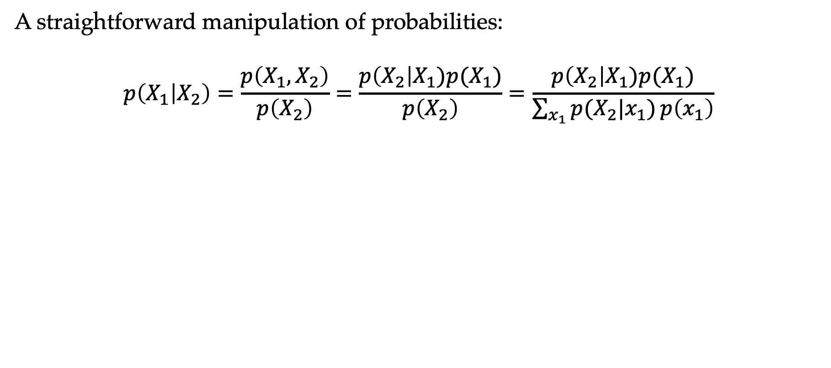
Bayes’ rule
A straightforward manipulation of probabilities:
$$p\left(X_{1} | X_{2}\right)=\frac{p\left(X_{1},X_{2}\right)}{p\left(X_{2}\right)}=\frac{p\left(X_{2}\right|X_{1})p(X_{1})}{p\left(X_{2}\right)}=\frac{p\left(X_{2}\right|X_{1})p(X_{1})}{\sum_{x_{1}}{p(X_{2}|x_{1})}p\left(x_{1}\right)}$$

Slide 18
Bayes’ rule: Q
I want to know if I have come down with a rare strain of flu (occurring in only 1/10,000 people). There is an “accurate” test for the flu: if I have the flu, it will tell me I have 99% of the time, and if I do not have it, it will tell me I do not have it 99% of the time. I go to the doctor and test positive. What is the probability I have this flu?
  ≈ 99%
  ≈ 10%
  ≈ 1%
  ≈ 0.1%

Slide 19
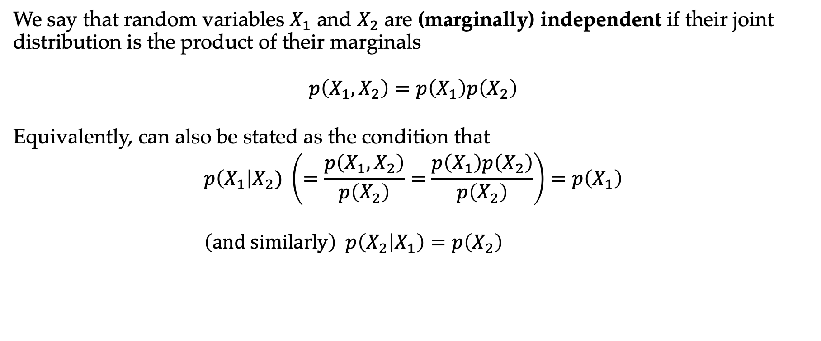
Independence
We say that random variables $X_{1}$ and $X_{2}$ are (marginally) independent if their joint distribution is the product of their marginals
$$p\left(X_{1},X_{2}\right)=p\left(X_{1}\right)p\left(X_{2}\right)$$
Equivalently, can also be stated as the condition that
$$p\left(X_{1}\right|X_{2}) \left(=\frac{p\left(X_{1},X_{2}\right)}{p\left(X_{2}\right)}=\frac{p\left(X_{1}\right)p\left(X_{2}\right)}{p\left(X_{2}\right)}\right)=p\left(X_{1}\right) \\ \left(and similarly\right) p\left(X_{2} | X_{1}\right)=p\left(X_{2}\right)$$

Slide 20
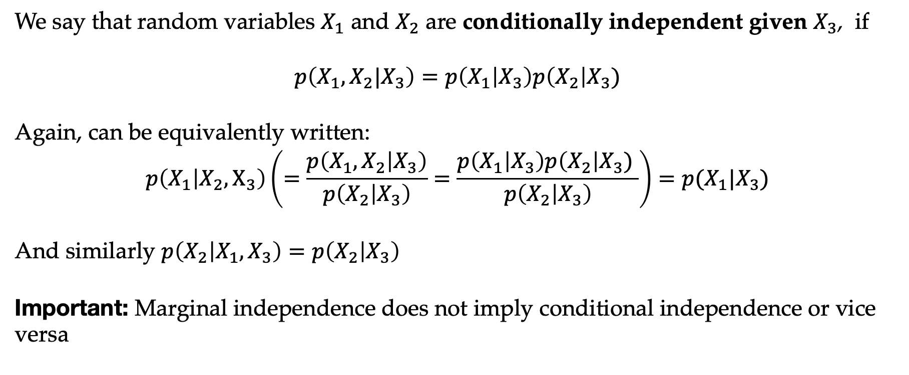
Conditional independence
We say that random variables $X_{1}$ and $X_{2}$ are conditionally independent given $X_{3}$, if
$$p\left(X_{1},X_{2}|X_{3}\right)=p\left(X_{1} | X_{3}\right)p\left(X_{2}\right|X_{3})$$
Again, can be equivalently written:
$$p\left(X_{1} | X_{2},X_{3}\right)\left(=\frac{p\left(X_{1},X_{2} | X_{3}\right)}{p\left(X_{2} | X_{3}\right)}=\frac{p\left(X_{1} | X_{3}\right)p\left(X_{2}\right|X_{3}) }{p\left(X_{2} | X_{3}\right)}\right)=p(X_{1}|X_{3})$$
And similarly $p\left(X_{2} | X_{1},X_{3}\right)=p\left(X_{2} | X_{3}\right)$
Important: Marginal independence does not imply conditional independence or vice versa

Slide 21
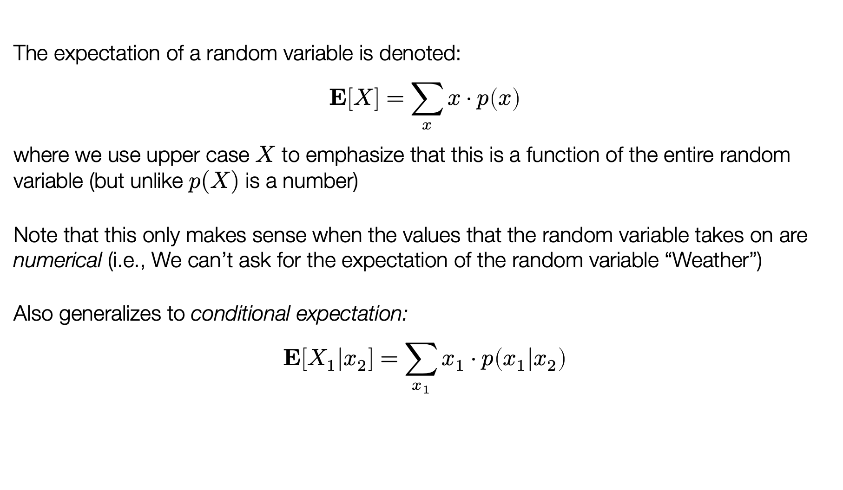
Expectation
The expectation of a random variable is denoted:
$$E\left[X\right]=\sum_{x}{x⋅p\left(x\right)}$$
where we use upper case $X$ to emphasize that this is a function of the entire random variable (but unlike $p(X)$ is a number)
Note that this only makes sense when the values that the random variable takes on are numerical (i.e., We can’t ask for the expectation of the random variable “Weather”)
Also generalizes to conditional expectation:
$$E\left[X_{1}|x_{2}\right]=\sum_{x_{1}}{x_{1}⋅p\left(x_{1}|x_{2}\right)}$$

Slide 22
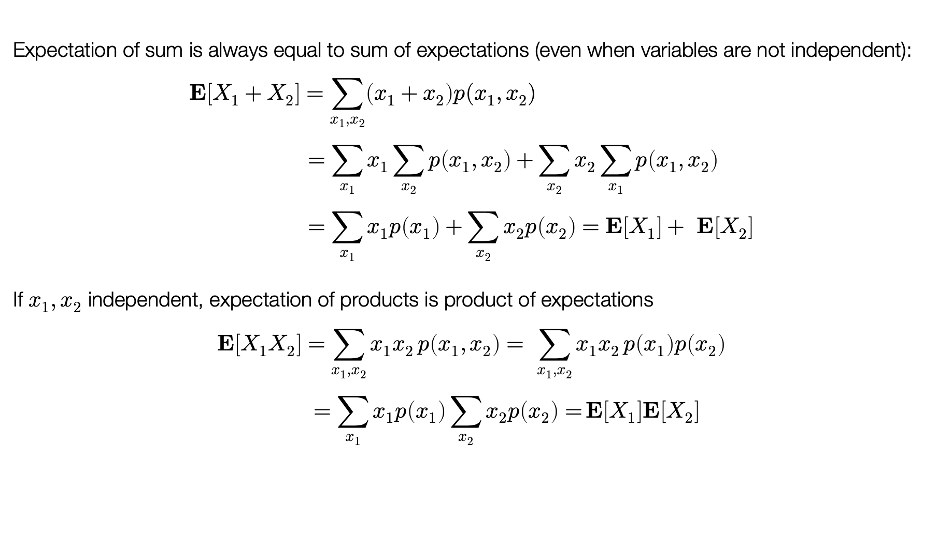
Rules of expectation
Expectation of sum is always equal to sum of expectations (even when variables are not independent):
$$E\left[X_{1}+X_{2}\right]=\sum_{x_{1},x_{2}}{\left(x_{1}+x_{2}\right)p(x_{1},x_{2})} \\ =\sum_{x_{1}}{x_{1}\sum_{x_{2}}{p\left(x_{1},x_{2}\right)+\sum_{x_{2}}{x_{2}}\sum_{x_{1}}{p\left(x_{1},x_{2}\right)}}} \\ =\sum_{x_{1}}{x_{1}p\left(x_{1}\right)+\sum_{x_{2}}{x_{2}p\left(x_{2}\right)}}=E\left[X_{1}\right]+ E\left[X_{2}\right]$$
If $x_{1},x_{2}$ independent, expectation of products is product of expectations
$$E\left[X_{1}X_{2}\right]=\sum_{x_{1},x_{2}}{x_{1}x_{2}}p\left(x_{1},x_{2}\right)= \sum_{x_{1},x_{2}}{x_{1}x_{2}}p\left(x_{1}\right)p\left(x_{2}\right) \\ =\sum_{x_{1}}{x_{1}p\left(x_{1}\right)\sum_{x_{2}}{x_{2}p\left(x_{2}\right)=}}E\left[X_{1}\right]E\left[X_{2}\right]$$

Slide 23
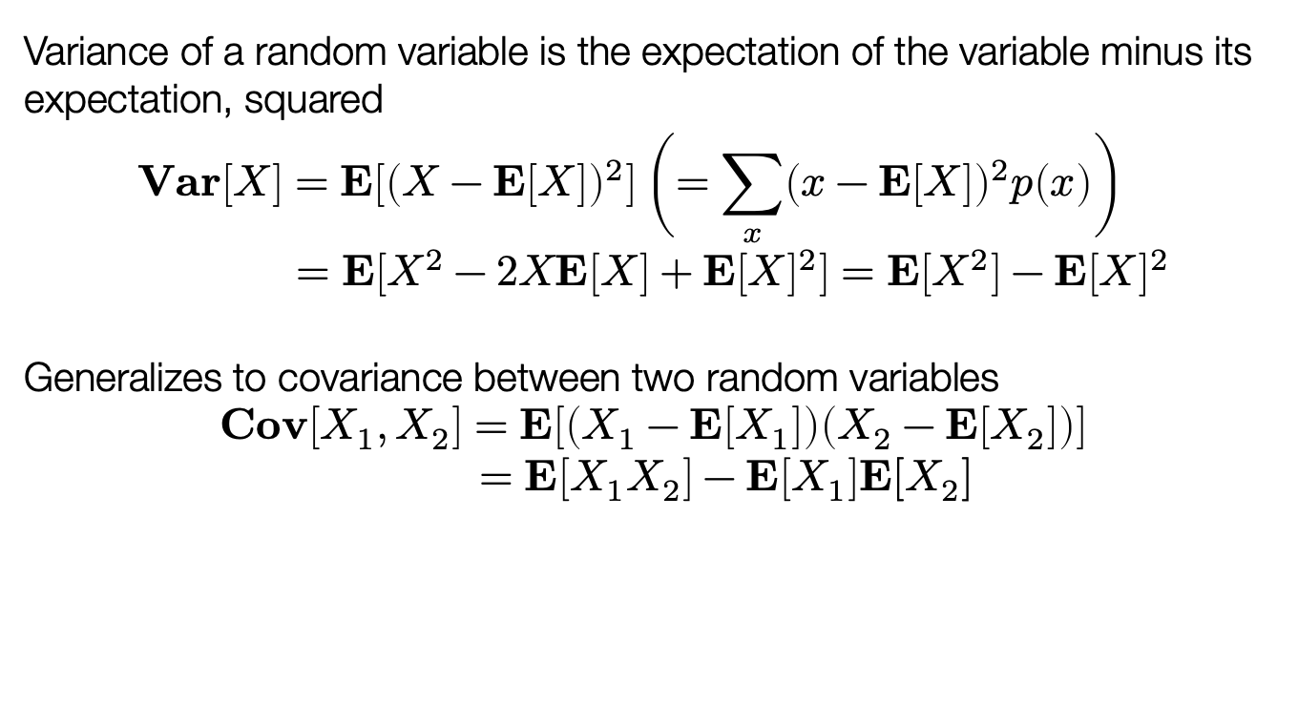
Variance
Variance of a random variable is the expectation of the variable minus its expectation, squared
$$Var\left[X\right]=E\left[{\left(X−E\left[X\right]\right)}^{2}\right]\left(=\sum_{x}{{\left(x−E\left[X\right]\right)}^{2}p\left(x\right)}\right) \\ =E\left[X^{2}−2XE\left[X\right]+E{\left[X\right]}^{2}\right]=E\left[X^{2}\right]−E{\left[X\right]}^{2}$$
Generalizes to covariance between two random variables
$$Cov\left[X_{1},X_{2}\right]=E\left[\left(X_{1}−E\left[X_{1}\right]\right)\left(X_{2}−E\left[X_{2}\right]\right)\right] \\ =E\left[X_{1}X_{2}\right]−E\left[X_{1}\right]E[X_{2}]$$

Slide 24
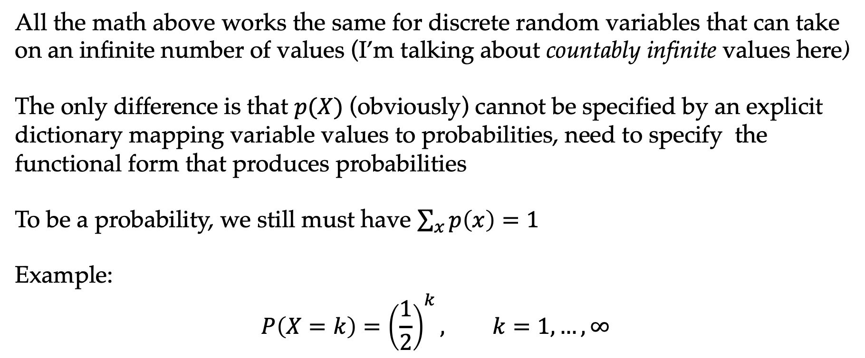
Infinite random variables
All the math above works the same for discrete random variables that can take on an infinite number of values (I’m talking about countably infinite values here)
The only difference is that $p(X)$ (obviously) cannot be specified by an explicit dictionary mapping variable values to probabilities, need to specify the functional form that produces probabilities
To be a probability, we still must have $\sum_{x}{p\left(x\right)=1}$
Example:
$$P\left(X=k\right)={\left(\frac{1}{2}\right)}^{k}, k=1,…,∞$$

Slide 25
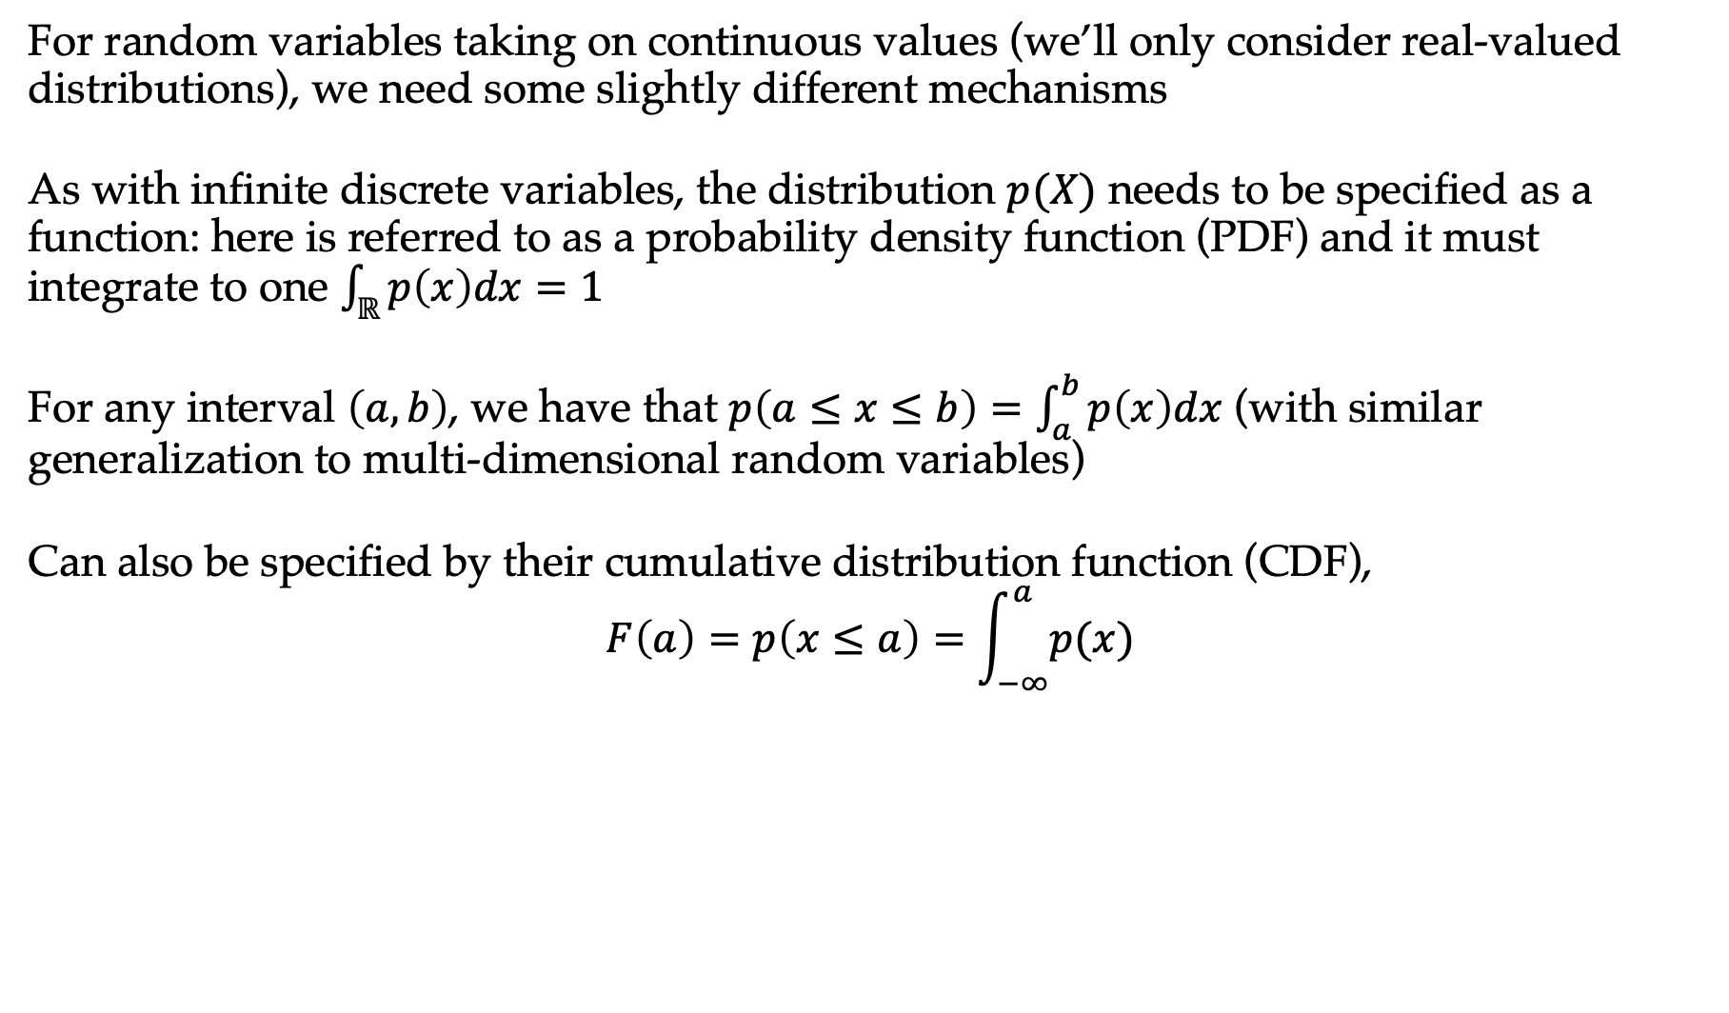
Continuous random variables
For random variables taking on continuous values (we’ll only consider real-valued distributions), we need some slightly different mechanisms
As with infinite discrete variables, the distribution $p(X)$ needs to be specified as a function: here is referred to as a probability density function (PDF) and it must integrate to one $\int_{ℝ}{p\left(x\right)dx=1}$
For any interval $\left(a,b\right)$, we have that $p\left(a≤x≤b\right)=\int_{a}^{b}{p\left(x\right)dx}$ (with similar generalization to multi-dimensional random variables)
Can also be specified by their cumulative distribution function (CDF),
$$F\left(a\right)=p\left(x≤a\right)=\int_{−∞}^{a}{p(x)}$$

Slide 26
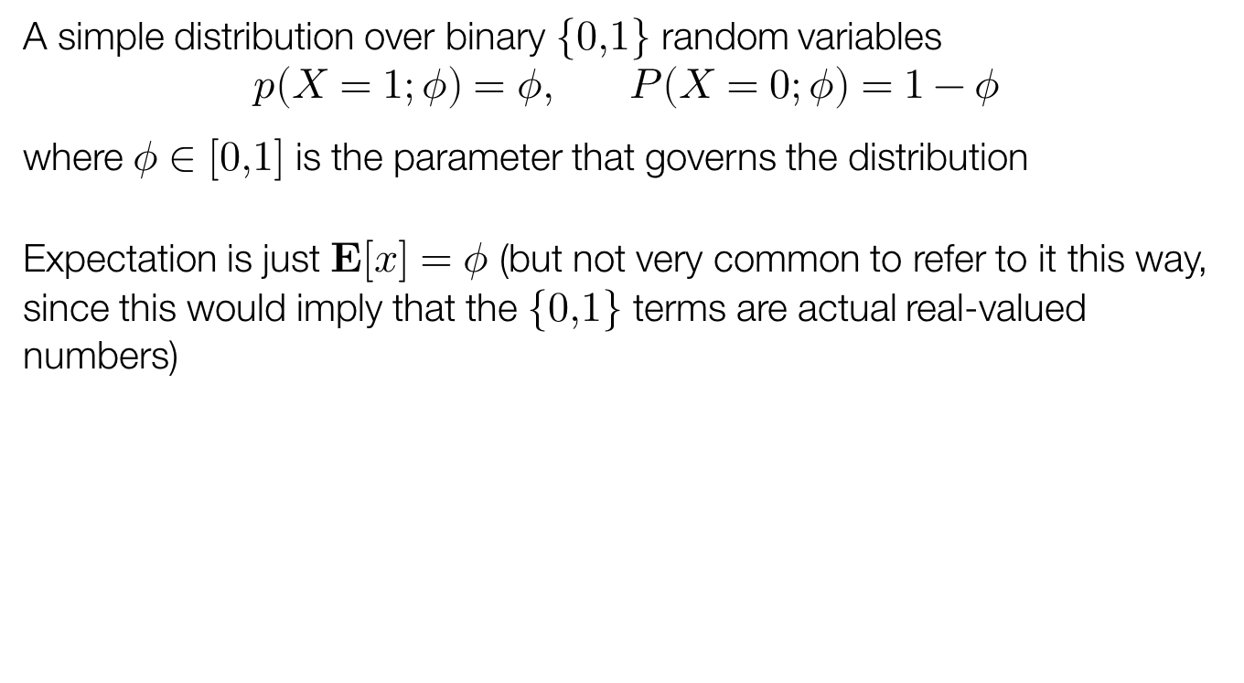
Bernoulli distribution
A simple distribution over binary $\{0,1\}$ random variables
$$p\left(X=1;φ\right)=φ, P\left(X=0;φ\right)=1−φ$$
where $φ∈[0,1]$ is the parameter that governs the distribution
Expectation is just $E\left[x\right]=φ$ (but not very common to refer to it this way, since this would imply that the $\{0,1\}$ terms are actual real-valued numbers)

Slide 27
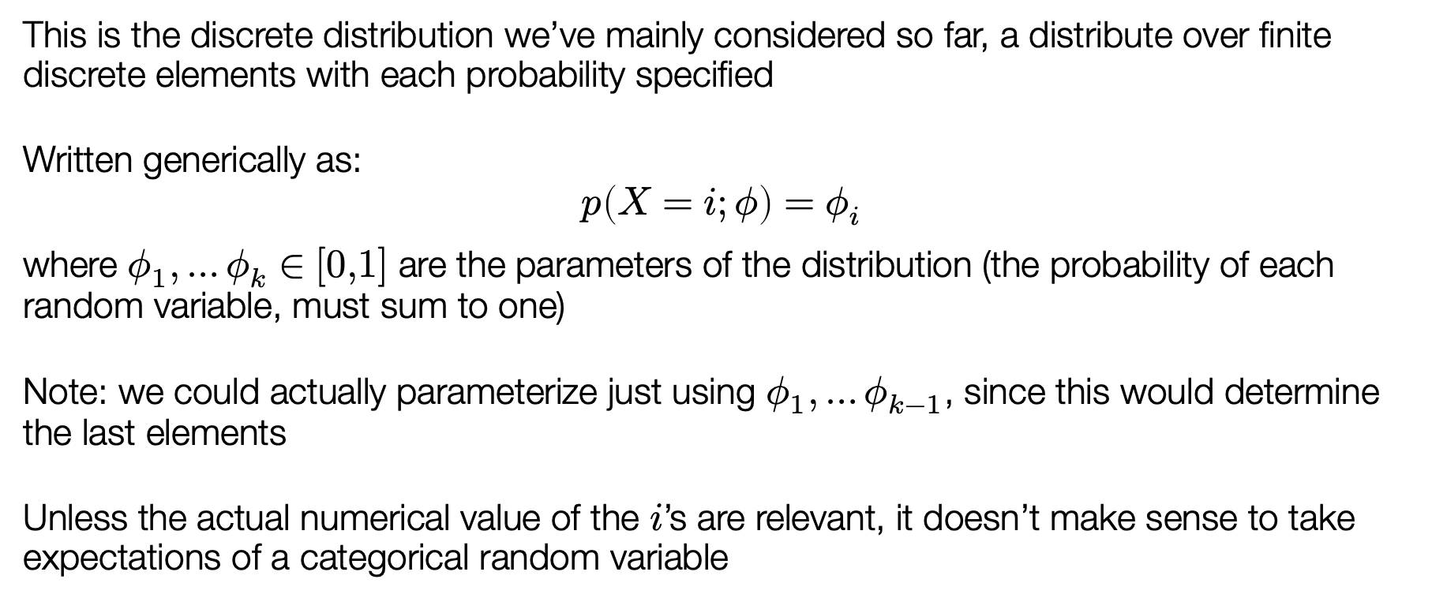
Categorical distribution
This is the discrete distribution we’ve mainly considered so far, a distribute over finite discrete elements with each probability specified
Written generically as:
$$p\left(X=i;φ\right)=φ_{i}$$
where $φ_{1},…φ_{k}∈[0,1]$ are the parameters of the distribution (the probability of each random variable, must sum to one)
Note: we could actually parameterize just using $φ_{1},…φ_{k−1}$, since this would determine the last elements
Unless the actual numerical value of the $i$’s are relevant, it doesn’t make sense to take expectations of a categorical random variable

Slide 28
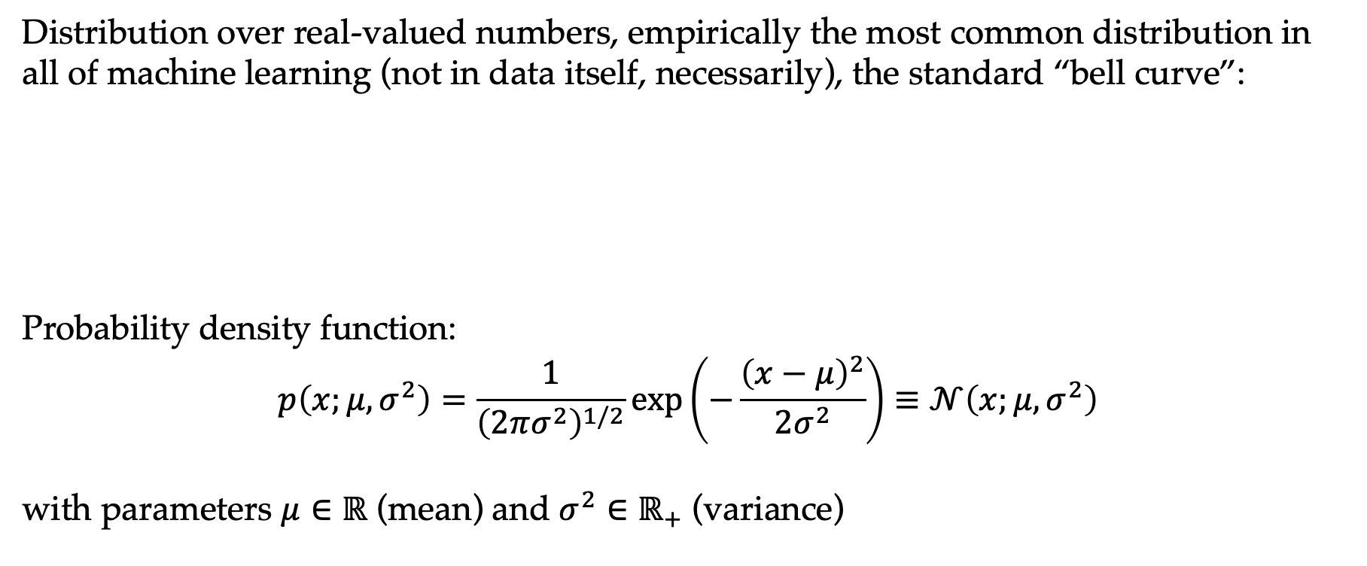
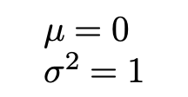
Gaussian distribution
Distribution over real-valued numbers, empirically the most common distribution in all of machine learning (not in data itself, necessarily), the standard “bell curve”:
Probability density function:
$$p\left(x;μ,σ^{2}\right)=\frac{1}{{\left(2πσ^{2}\right)}^{1/2}}\exp\left(−\frac{{\left(x−μ\right)}^{2}}{2σ^{2}}\right)≡𝒩\left(x;μ,σ^{2}\right)$$
with parameters $μ∈ℝ$ (mean) and $σ^{2}∈ℝ_{+}$ (variance)
$$μ=0 \\ σ^{2}=1$$

Slide 29
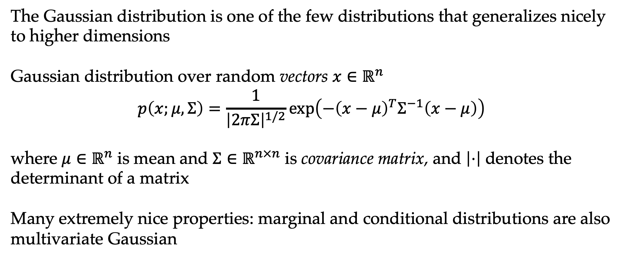
Multivariate Gaussians
The Gaussian distribution is one of the few distributions that generalizes nicely to higher dimensions
Gaussian distribution over random vectors $x∈ℝ^{n}$
$$p\left(x;μ,Σ\right)=\frac{1}{{\left|2πΣ\right|}^{1/2}}\exp\left(−{\left(x−μ\right)}^{T}Σ^{−1}\left(x−μ\right)\right)$$
where $μ∈ℝ^{n}$ is mean and $Σ∈ℝ^{n×n}$ is covariance matrix, and $\left|⋅\right|$ denotes the determinant of a matrix
Many extremely nice properties: marginal and conditional distributions are also multivariate Gaussian

Slide 30
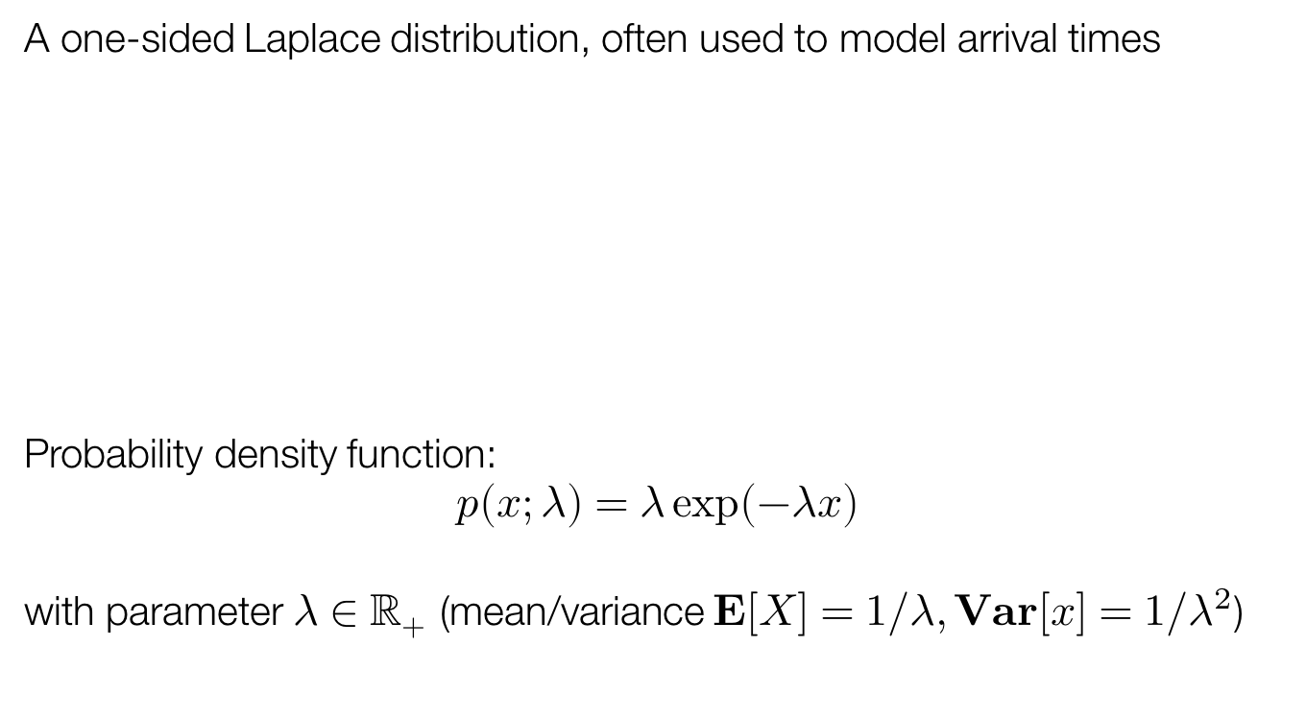

Exponential distribution
A one-sided Laplace distribution, often used to model arrival times
Probability density function:
$$p\left(x;λ\right)=λ\exp\left(−λx\right)$$
with parameter $λ∈ℝ_{+}$ (mean/variance $E\left[X\right]=1/λ, Var\left[x\right]=1/λ^{2}$)
$$λ=1$$

Slide 31
Outline
Probability in AI
Background
Maximum likelihood estimation

Slide 32
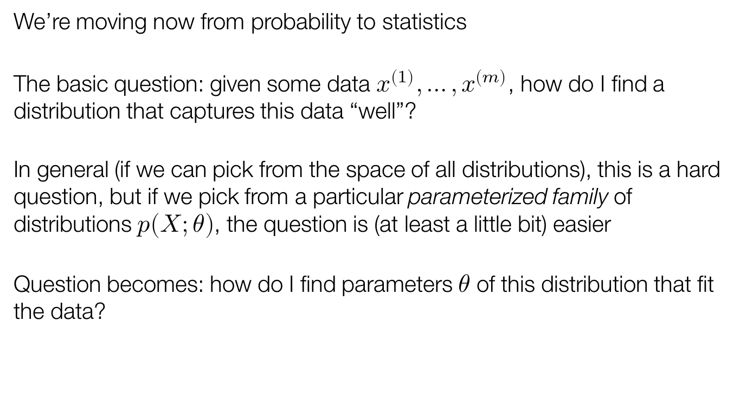
Estimating the parameters of distributions
We’re moving now from probability to statistics
The basic question: given some data $x^{\left(1\right)}, …, x^{\left(m\right)}$, how do I find a distribution that captures this data “well”?
In general (if we can pick from the space of all distributions), this is a hard question, but if we pick from a particular parameterized family of distributions $p\left(X;θ\right)$, the question is (at least a little bit) easier
Question becomes: how do I find parameters $θ$ of this distribution that fit the data?

Slide 33
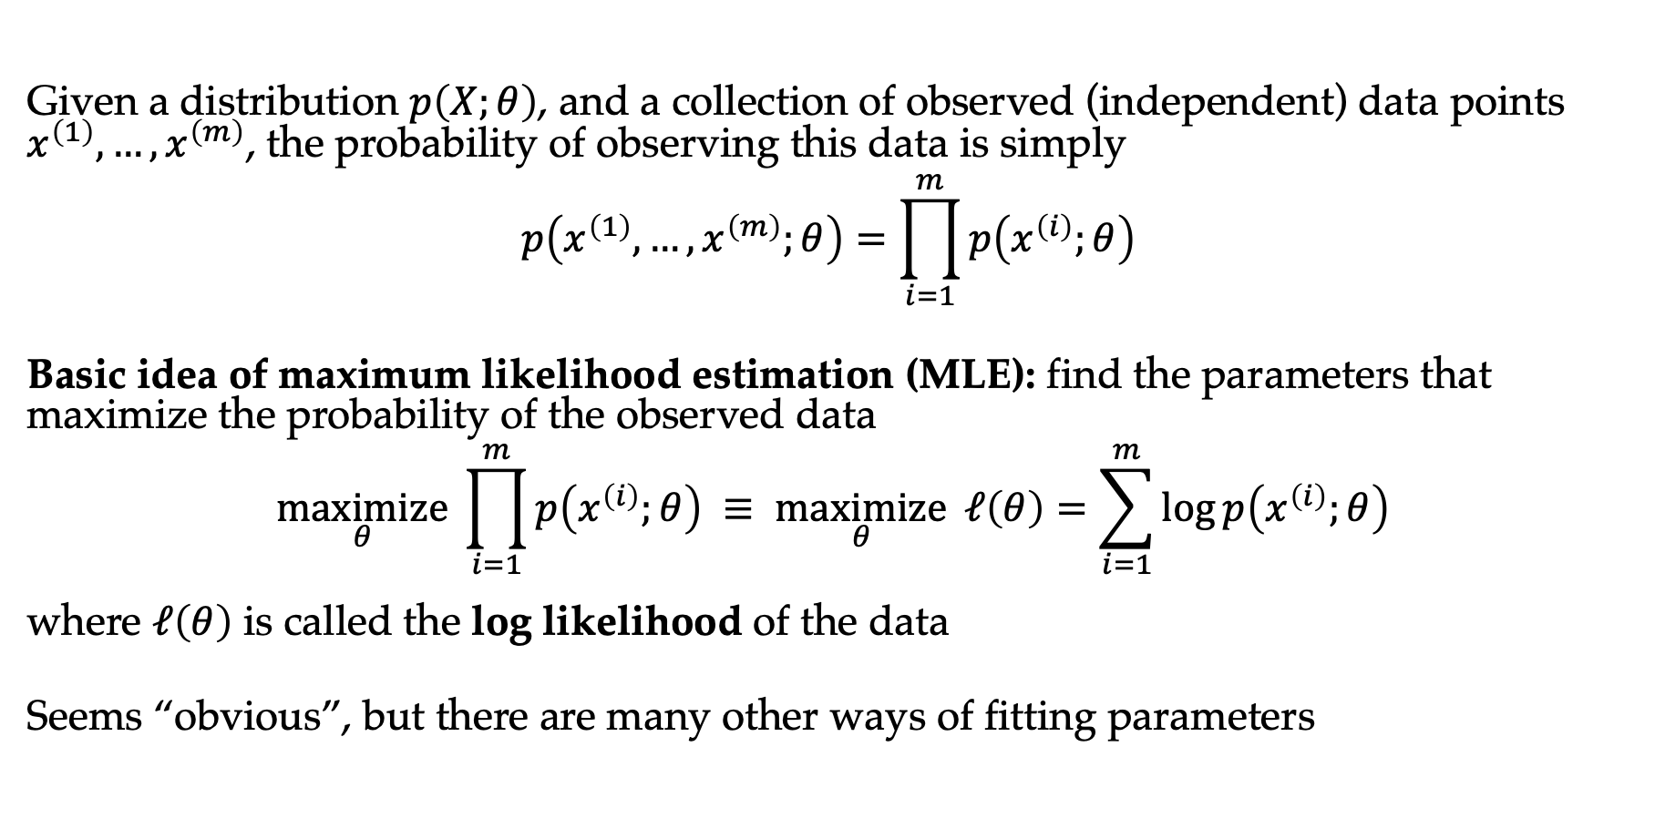
Maximum likelihood estimation
Given a distribution $p\left(X;θ\right)$, and a collection of observed (independent) data points $x^{\left(1\right)},…, x^{\left(m\right)}$, the probability of observing this data is simply
$$p\left(x^{\left(1\right)},…,x^{\left(m\right)};θ\right)=\prod_{i=1}^{m}{p\left(x^{\left(i\right)};θ\right)}$$
Basic idea of maximum likelihood estimation (MLE): find the parameters that maximize the probability of the observed data
$$\underset{θ}{maximize} \prod_{i=1}^{m}{p\left(x^{\left(i\right)};θ\right) ≡ \underset{θ}{maximize}} ℓ\left(θ\right)=\sum_{i=1}^{m}{\log{p\left(x^{\left(i\right)};θ\right)}}$$
where $ℓ\left(θ\right)$ is called the log likelihood of the data
Seems “obvious”, but there are many other ways of fitting parameters

Slide 34
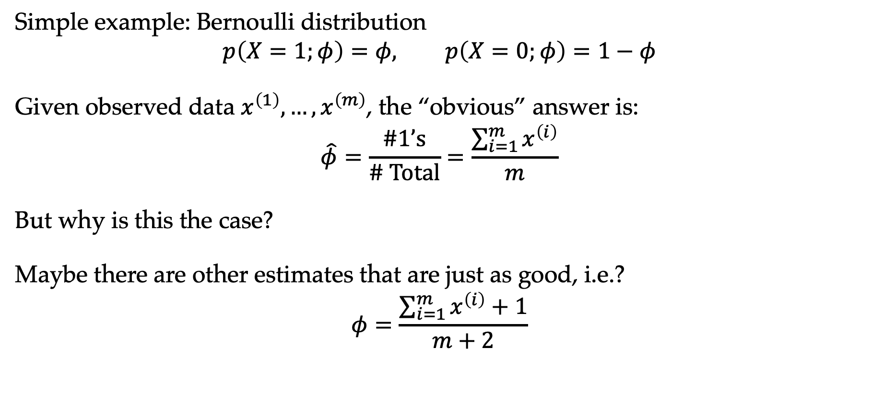
Parameter estimation for Bernoulli
Simple example: Bernoulli distribution
$$p\left(X=1;φ\right)=φ, p\left(X=0;φ\right)=1−φ$$
Given observed data $x^{\left(1\right)},…,x^{\left(m\right)}$, the “obvious” answer is:
$$\hat{φ}=\frac{\#1’s}{\# Total}=\frac{\sum_{i=1}^{m}{x^{\left(i\right)}}}{m}$$
But why is this the case?
Maybe there are other estimates that are just as good, i.e.?
$$φ=\frac{\sum_{i=1}^{m}{x^{\left(i\right)}}+1}{m+2}$$

Slide 35
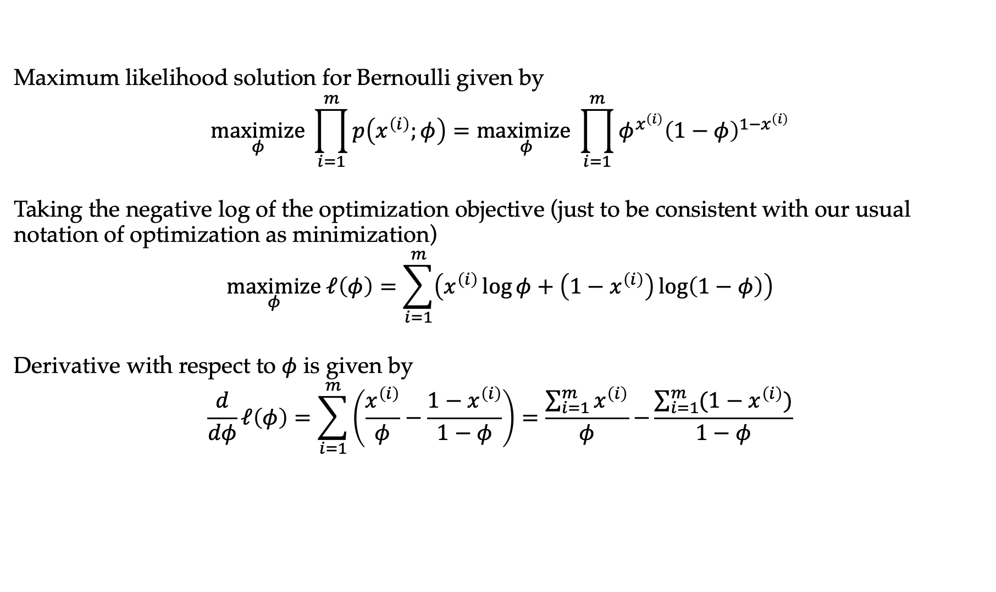
MLE for Bernoulli
Maximum likelihood solution for Bernoulli given by
$$\underset{φ}{maximize} \prod_{i=1}^{m}{p\left(x^{\left(i\right)};φ\right)}=\underset{φ}{maximize}\prod_{i=1}^{m}{φ^{x^{\left(i\right)}}{\left(1−φ\right)}^{{1−x}^{\left(i\right)}}}$$
Taking the negative log of the optimization objective (just to be consistent with our usual notation of optimization as minimization)
$$\underset{φ}{maximize} ℓ\left(φ\right)=\sum_{i=1}^{m}{\left(x^{\left(i\right)}\log{φ}+\left(1−x^{\left(i\right)}\right)\log\left(1−φ\right)\right)}$$
Derivative with respect to $φ$ is given by
$$\frac{d}{dφ}ℓ\left(φ\right)=\sum_{i=1}^{m}{\left(\frac{x^{\left(i\right)}}{φ}−\frac{1−x^{\left(i\right)}}{1−φ}\right)=\frac{\sum_{i=1}^{m}{x^{\left(i\right)}}}{φ}−}\frac{\sum_{i=1}^{m}{(1−x^{\left(i\right)})}}{1−φ}$$

Slide 36
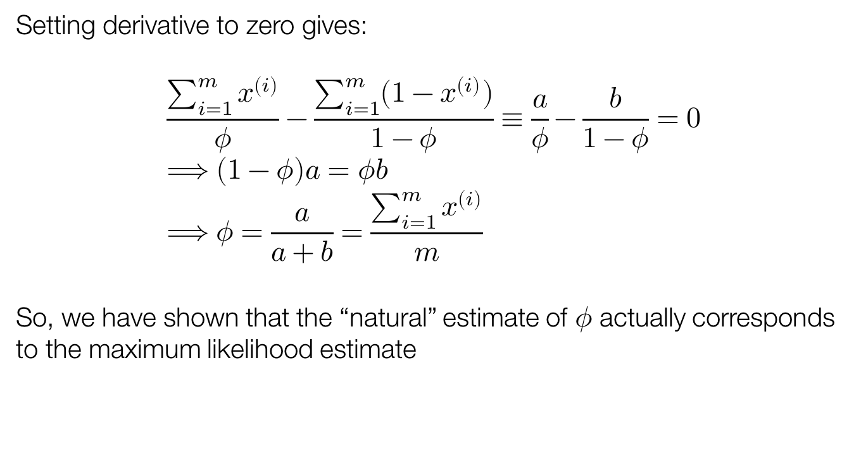
MLE for Bernoulli, continued
Setting derivative to zero gives:
$$\frac{\sum_{i=1}^{m}{x^{\left(i\right)}}}{φ}−\frac{\sum_{i=1}^{m}{(1−x^{\left(i\right)})}}{1−φ}≡\frac{a}{φ}−\frac{b}{1−φ}=0 \\ ⟹\left(1−φ\right)a=φb \\ ⟹φ=\frac{a}{a+b}=\frac{\sum_{i=1}^{m}{x^{\left(i\right)}}}{m}$$
So, we have shown that the “natural” estimate of $φ$ actually corresponds to the maximum likelihood estimate

Slide 37
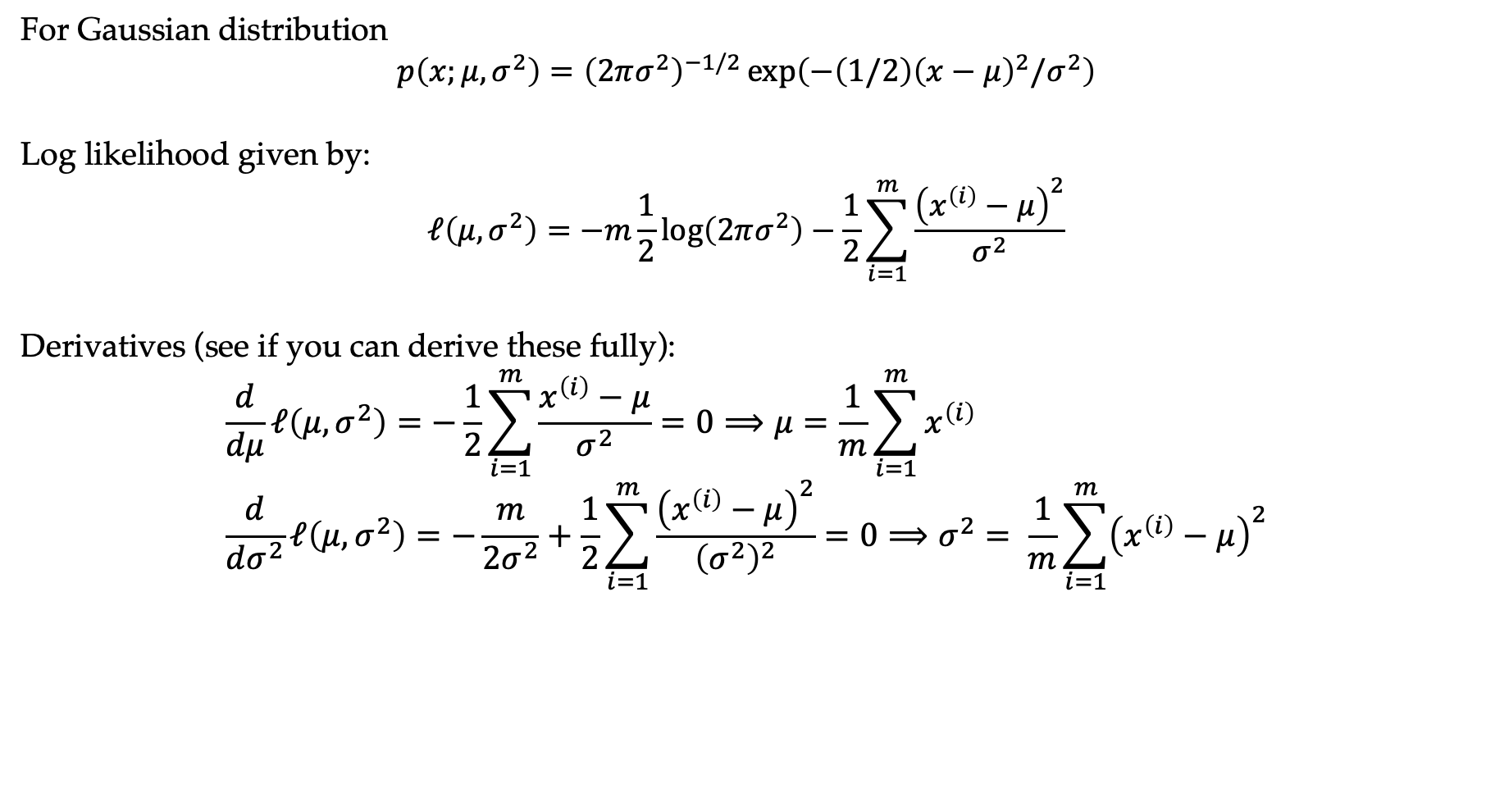
MLE for Gaussian, briefly
For Gaussian distribution
$$p\left(x;μ,σ^{2}\right)={\left(2πσ^{2}\right)}^{−1/2}\exp\left(−\left(1/2\right){\left(x−μ\right)}^{2}/σ^{2}\right)$$
Log likelihood given by:
$$ℓ\left(μ,σ^{2}\right)=−m\frac{1}{2}\log\left(2πσ^{2}\right)−\frac{1}{2}\sum_{i=1}^{m}{\frac{{\left(x^{\left(i\right)}−μ\right)}^{2}}{σ^{2}}}$$
Derivatives (see if you can derive these fully):
$$\frac{d}{dμ}ℓ\left(μ,σ^{2}\right)=−\frac{1}{2}\sum_{i=1}^{m}{\frac{x^{\left(i\right)}−μ}{σ^{2}}}=0⟹μ=\frac{1}{m}\sum_{i=1}^{m}{x^{\left(i\right)}} \\ \frac{d}{dσ^{2}}ℓ\left(μ,σ^{2}\right)=−\frac{m}{2σ^{2}}+\frac{1}{2}\sum_{i=1}^{m}{\frac{{\left(x^{\left(i\right)}−μ\right)}^{2}}{{\left(σ^{2}\right)}^{2}}}=0⟹σ^{2}= \frac{1}{m}\sum_{i=1}^{m}{{\left(x^{\left(i\right)}−μ\right)}^{2}}$$

Slide 38
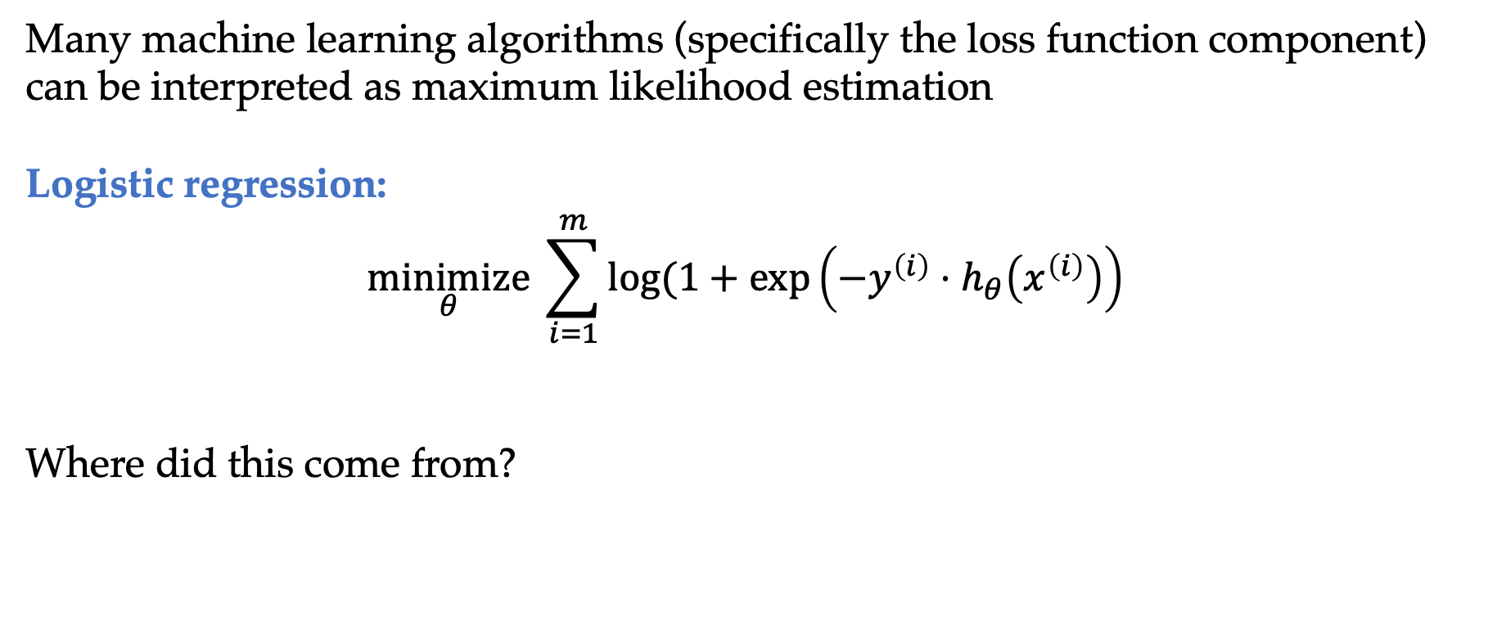
Machine learning via maximum likelihood
Many machine learning algorithms (specifically the loss function component) can be interpreted as maximum likelihood estimation
Logistic regression:
$$\underset{θ}{minimize}{\sum_{i=1}^{m}{log⁡(1+\exp\left(−y^{\left(i\right)}⋅h_{θ}\left(x^{\left(i\right)}\right)\right)} }$$
Where did this come from?

Slide 39
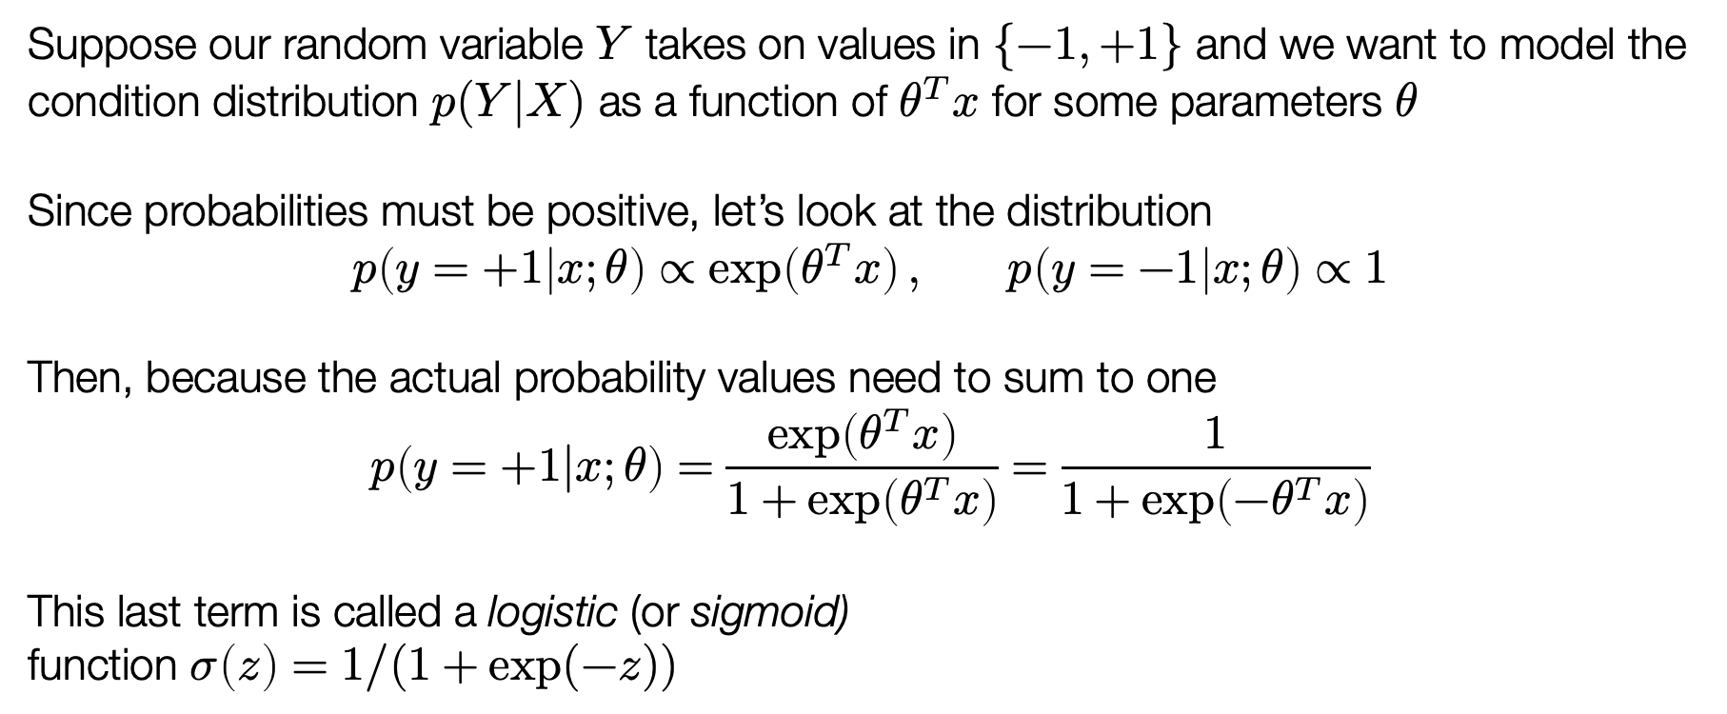
Logistic model
Suppose our random variable $Y$ takes on values in $\{−1,+1\}$ and we want to model the condition distribution $p(Y|X)$ as a function of $θ^{T}x$ for some parameters $θ$
Since probabilities must be positive, let’s look at the distribution
$$p\left(y=+1 | x;θ\right)∝\exp\left(θ^{T}x\right), p\left(y=−1 | x;θ\right)∝1$$
Then, because the actual probability values need to sum to one
$$p\left(y=+1|x;θ\right)=\frac{\exp\left(θ^{T}x\right)}{1+\exp\left(θ^{T}x\right)}=\frac{1}{1+\exp\left({−θ}^{T}x\right)}$$
This last term is called a logistic (or sigmoid)
function $σ\left(z\right)=1/(1+\exp{(−z))}$

Slide 40
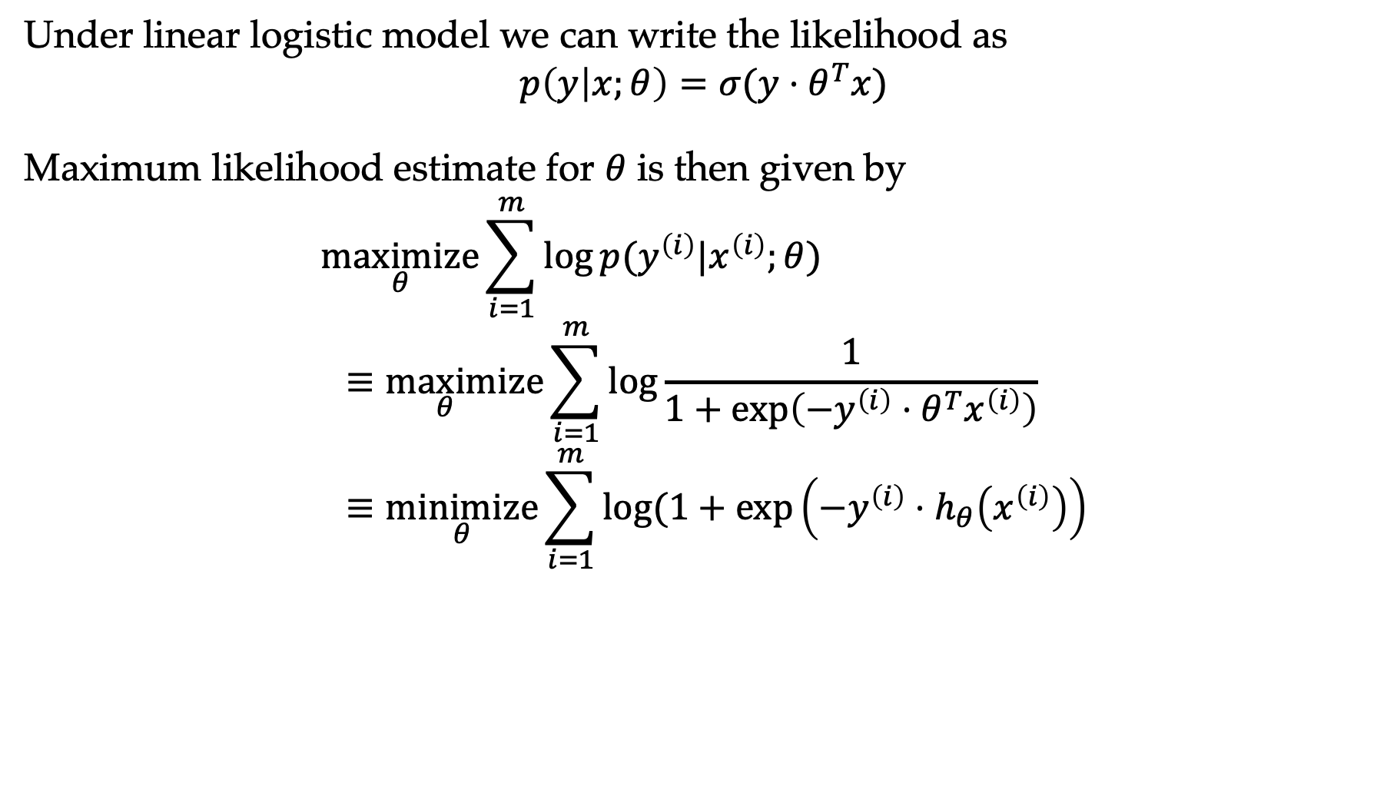
Logistic probability model
Under linear logistic model we can write the likelihood as
$$p\left(y | x;θ\right)=σ(y⋅θ^{T}x)$$
Maximum likelihood estimate for $θ$ is then given by
$$\underset{θ}{maximize}{\sum_{i=1}^{m}{\log{p(y^{\left(i\right)}|x^{\left(i\right)};θ)}}} \\ \underset{θ}{≡maximize}{\sum_{i=1}^{m}{log\frac{1}{1+\exp\left(−y^{\left(i\right)}⋅θ^{T}x^{\left(i\right)}\right)}}} \\ ≡\underset{θ}{minimize}{\sum_{i=1}^{m}{log⁡(1+\exp\left(−y^{\left(i\right)}⋅h_{θ}\left(x^{\left(i\right)}\right)\right)}}$$

Slide 41
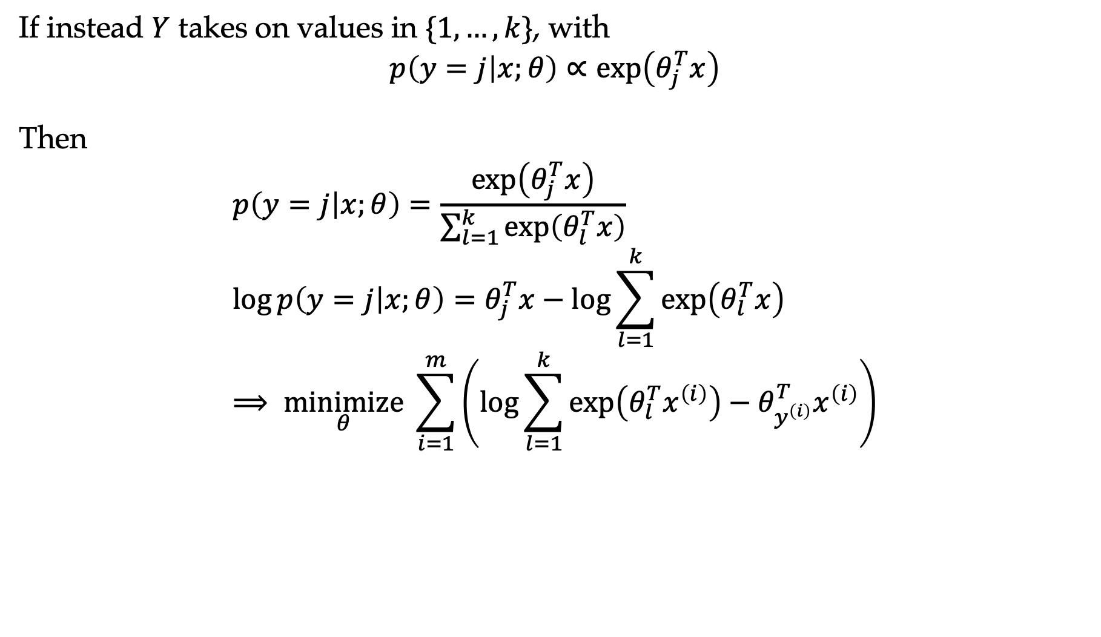
Softmax regression model
If instead $Y$ takes on values in $\{1,…,k\}$, with
$$p\left(y=j | x;θ\right)∝\exp\left(θ_{j}^{T}x\right)$$
Then
$$p\left(y=j | x;θ\right)=\frac{\exp\left(θ_{j}^{T}x\right)}{\sum_{l=1}^{k}{\exp\left(θ_{l}^{T}x\right)}} \\ \log{p\left(y=j | x;θ\right)}=θ_{j}^{T}x−\log{\sum_{l=1}^{k}{\exp\left(θ_{l}^{T}x\right)}} \\ ⟹ \underset{θ}{minimize}{\sum_{i=1}^{m}{\left(\log{\sum_{l=1}^{k}{\exp\left(θ_{l}^{T}x^{\left(i\right)}\right)}−θ_{y^{\left(i\right)}}^{T}x^{\left(i\right)}}\right)}}$$

Slide 42
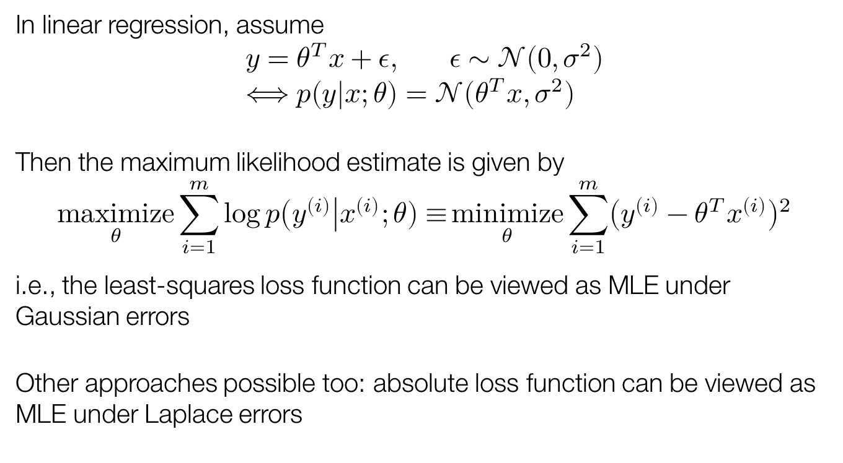
Least squares
In linear regression, assume
$$y=θ^{T}x+ε, ε∼𝒩\left(0,σ^{2}\right) \\ ⟺p\left(y | x;θ\right)=𝒩\left(θ^{T}x,σ^{2}\right)$$
Then the maximum likelihood estimate is given by
$$\underset{θ}{maximize}{\sum_{i=1}^{m}{\log{p\left(y^{\left(i\right)}\right|x^{\left(i\right)};θ)≡}}\underset{θ}{minimize}}\sum_{i=1}^{m}{{\left(y^{\left(i\right)}−θ^{T}x^{\left(i\right)}\right)}^{2}}$$
i.e., the least-squares loss function can be viewed as MLE under Gaussian errors
Other approaches possible too: absolute loss function can be viewed as MLE under Laplace errors

Slide 43
Outline
Probability in AI
Background
Maximum likelihood estimation

Slide 44
Graphical models
Modeling
  How do we represent the structure we want to capture (graphical models)
Inference
  We have parameters of the graph
  Some variables are known, what’s the distribution over hidden variables?
Learning
  Estimating the parameters of the graph from data

Slide 45
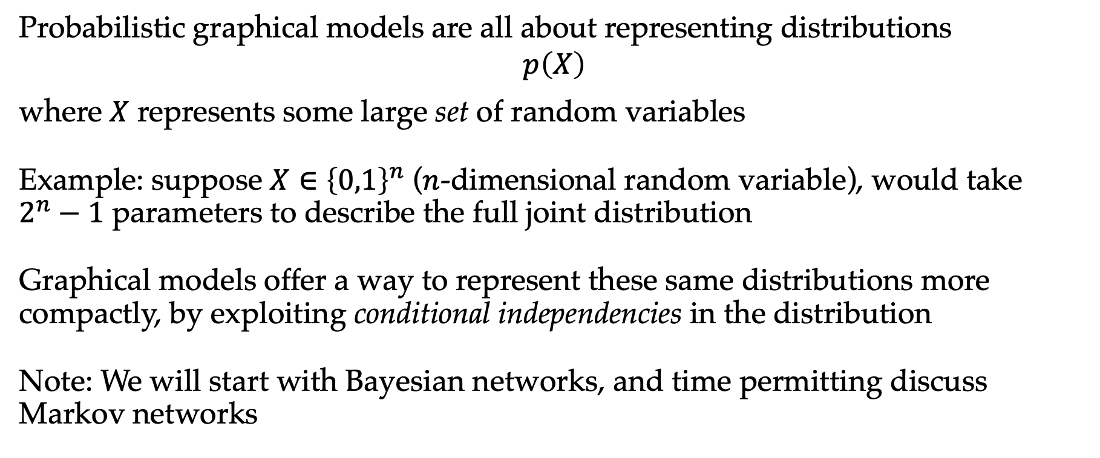
Probabilistic graphical models
Probabilistic graphical models are all about representing distributions
$$p\left(X\right)$$
where $X$ represents some large set of random variables
Example: suppose $X∈{\left\{0,1\right\}}^{n}$ ($n$-dimensional random variable), would take $2^{n}−1$ parameters to describe the full joint distribution
Graphical models offer a way to represent these same distributions more compactly, by exploiting conditional independencies in the distribution
Note: We will start with Bayesian networks, and time permitting discuss Markov networks

Slide 46
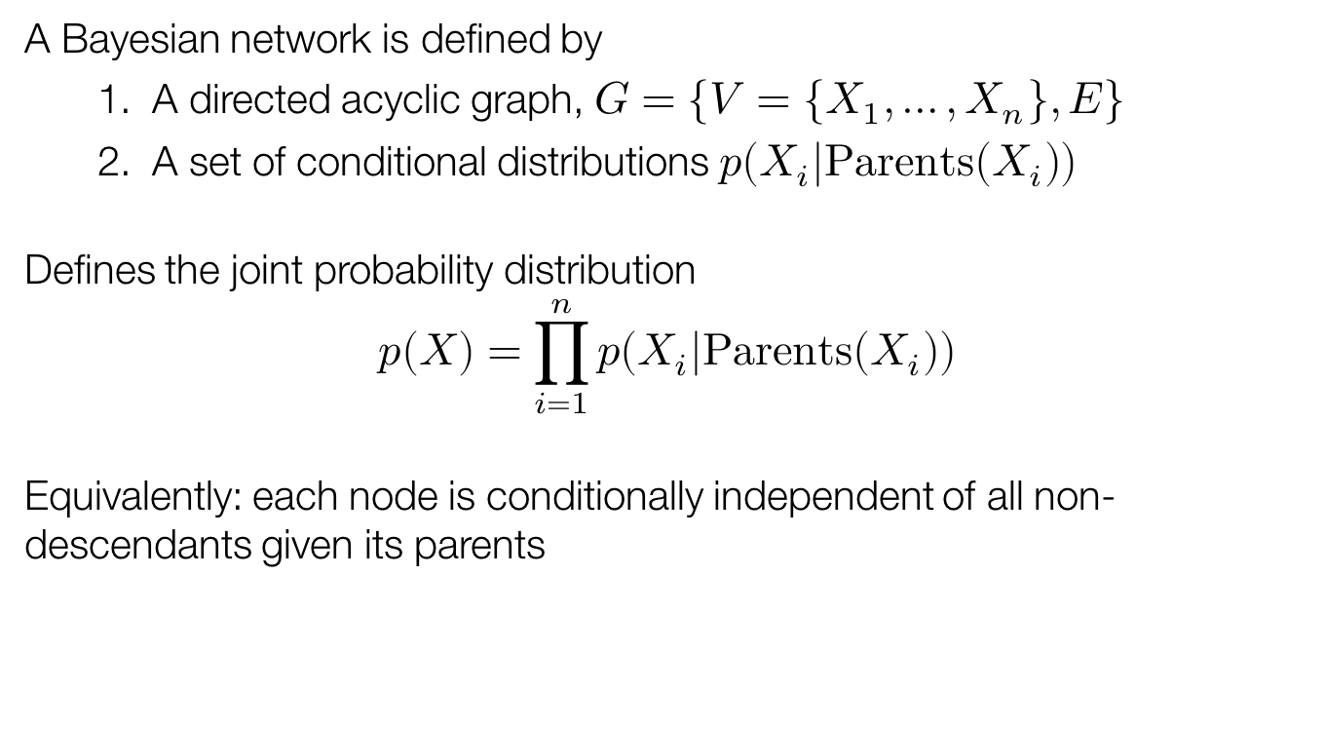
Bayesian networks
A Bayesian network is defined by
  A directed acyclic graph, $G=\{V=\left\{X_{1},…,X_{n}\right\}, E\}$
  A set of conditional distributions $p\left(X_{i} | Parents\left(X_{i}\right)\right)$
Defines the joint probability distribution
$$p\left(X\right)=\prod_{i=1}^{n}{p\left(X_{i} | Parents\left(X_{i}\right)\right)}$$
Equivalently: each node is conditionally independent of all non-descendants given its parents

Slide 47
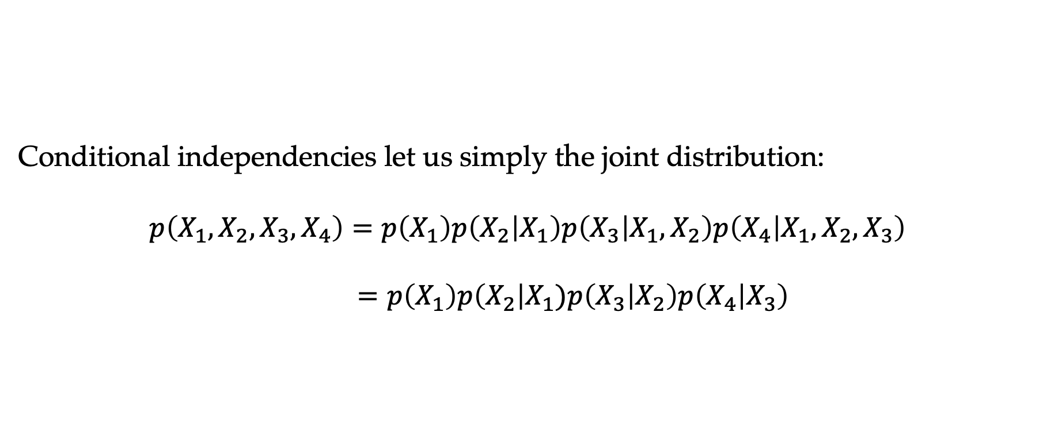
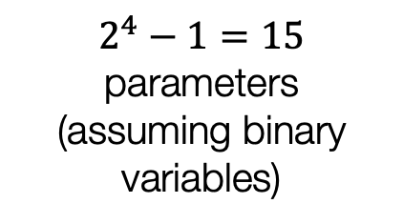
Example Bayesian network
Conditional independencies let us simply the joint distribution:
$$p\left(X_{1},X_{2},X_{3},X_{4}\right)=p\left(X_{1}\right)p\left(X_{2} | X_{1}\right)p\left(X_{3} | X_{1},X_{2}\right)p\left(X_{4} | X_{1},X_{2},X_{3}\right) \\ =p\left(X_{1}\right)p\left(X_{2}\right|X_{1})p\left(X_{3} | X_{2}\right)p\left(X_{4} | X_{3}\right)$$
$2^{4}−1=15$ parameters (assuming binary variables)

Slide 48
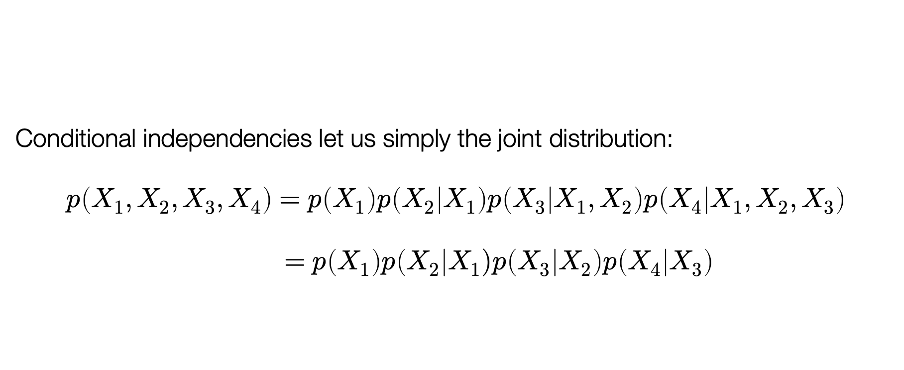

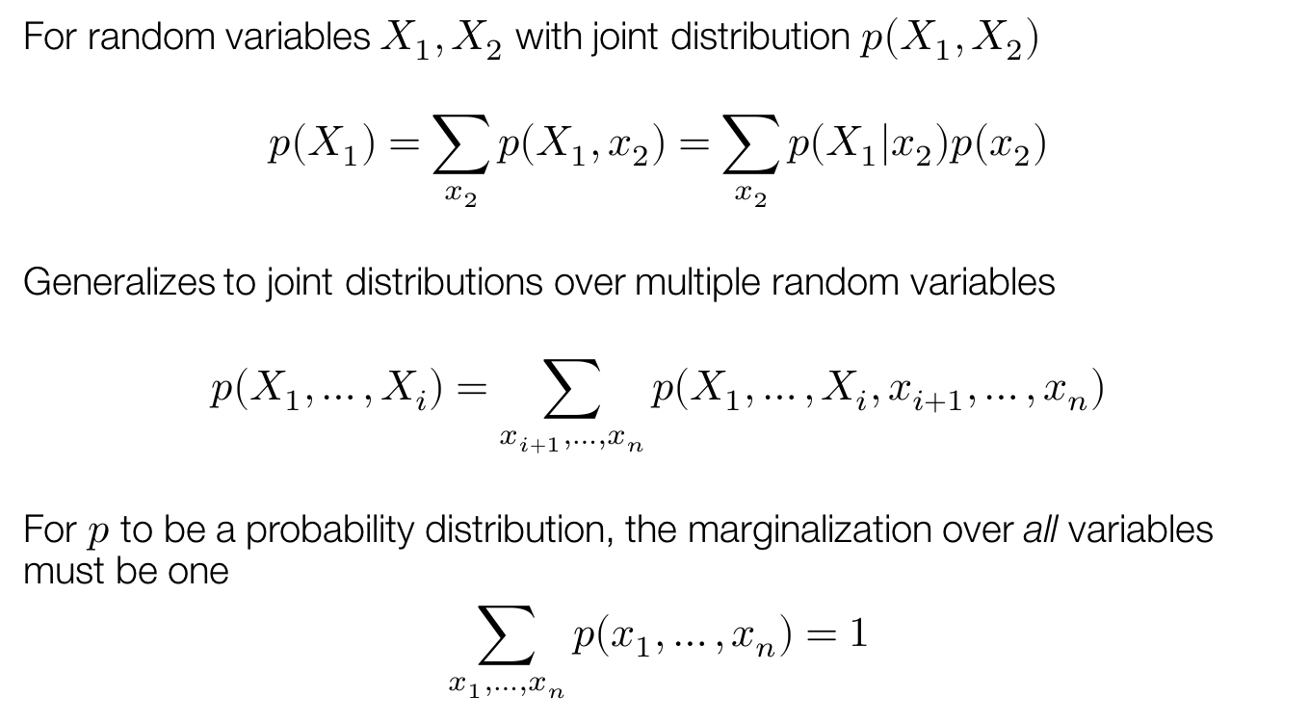
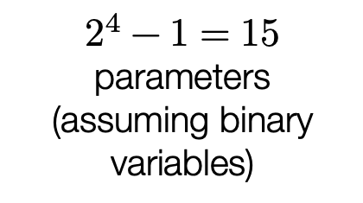
Example Bayesian network
Conditional independencies let us simply the joint distribution:
$$p\left(X_{1},X_{2},X_{3},X_{4}\right)=p\left(X_{1}\right)p\left(X_{2} | X_{1}\right)p\left(X_{3} | X_{1},X_{2}\right)p\left(X_{4} | X_{1},X_{2},X_{3}\right) \\ =p\left(X_{1}\right)p\left(X_{2}\right|X_{1})p\left(X_{3} | X_{2}\right)p\left(X_{4} | X_{3}\right)$$
$2^{4}−1=15$ parameters (assuming binary variables)
$1$ parameter
$2$ parameters

Slide 49
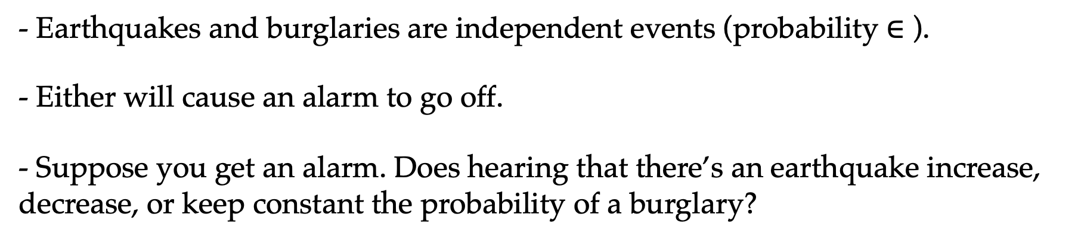
Example Bayesian Network
- Earthquakes and burglaries are independent events (probability $∈$ ).
- Either will cause an alarm to go off.
- Suppose you get an alarm. Does hearing that there’s an earthquake increase, decrease, or keep constant the probability of a burglary?

Slide 50
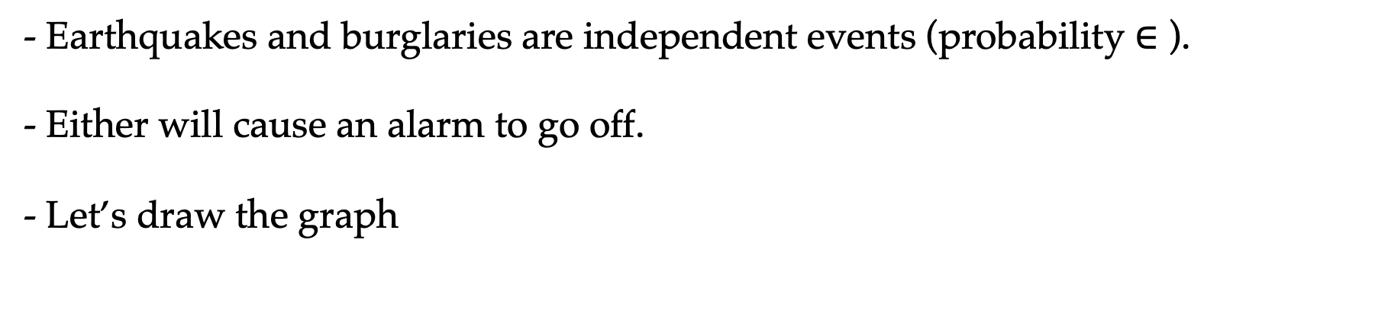
Example Bayesian Network
- Earthquakes and burglaries are independent events (probability $∈$ ).
- Either will cause an alarm to go off.
- Let’s draw the graph

Slide 51
Explaining away
Suppose two causes positively influence an effect. Conditioned on the effect, further conditioning on one cause reduces the probability of the other cause
The effect is “explained away” by one cause

Slide 52
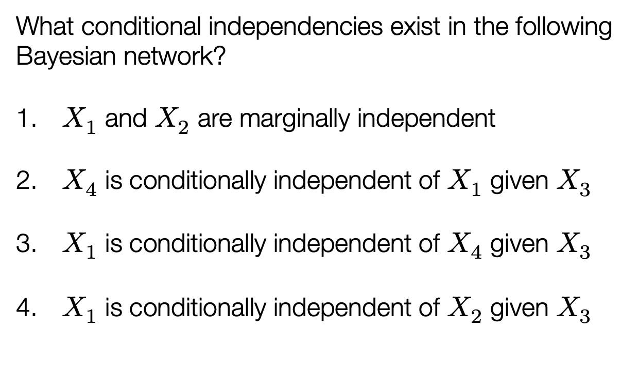
Independences
What conditional independencies exist in the following Bayesian network?
$X_{1}$ and $X_{2}$ are marginally independent
$X_{4}$ is conditionally independent of $X_{1}$ given $X_{3}$
$X_{1}$ is conditionally independent of $X_{4}$ given $X_{3}$
$X_{1}$ is conditionally independent of $X_{2}$ given $X_{3}$

Slide 53
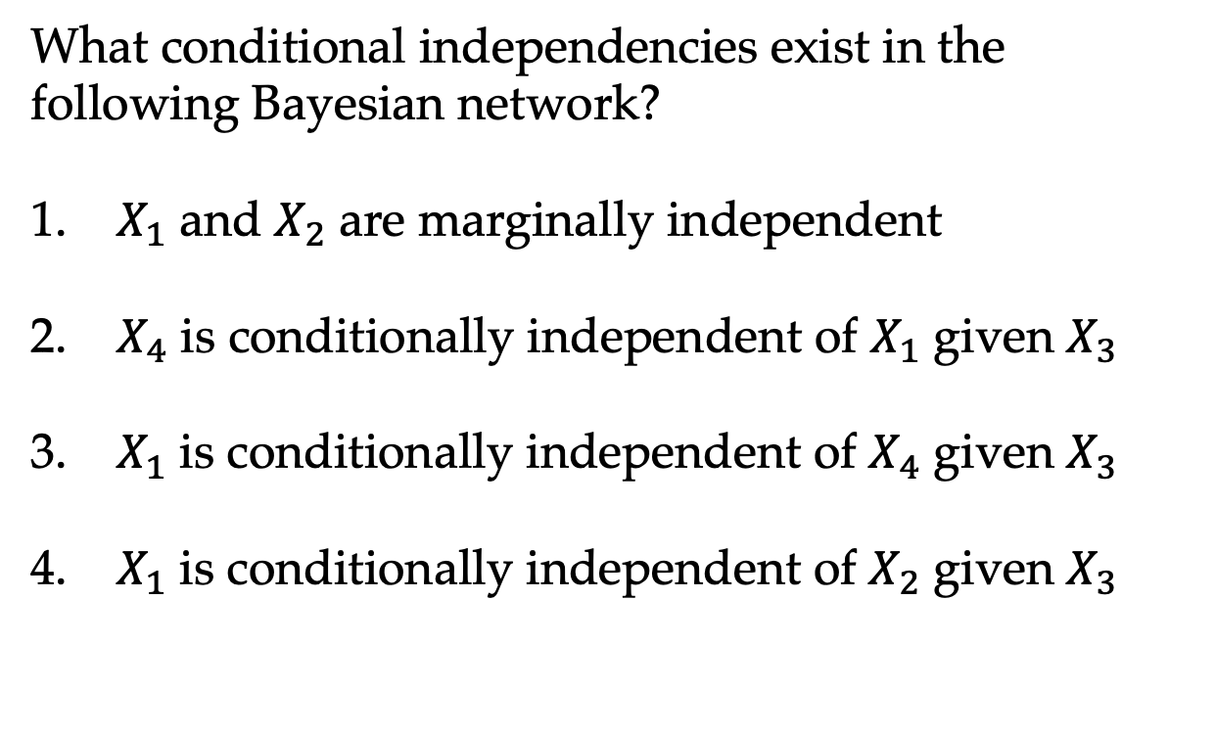
Independences
What conditional independencies exist in the following Bayesian network?
$X_{1}$ and $X_{2}$ are marginally independent
$X_{4}$ is conditionally independent of $X_{1}$ given $X_{3}$
$X_{1}$ is conditionally independent of $X_{4}$ given $X_{3}$
$X_{1}$ is conditionally independent of $X_{2}$ given $X_{3}$

Slide 54
Independences
Causal chain
Common cause
Common effect

Slide 55
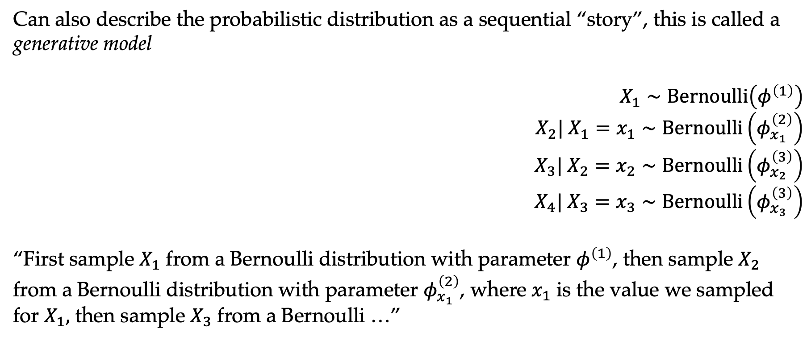
Generative model
Can also describe the probabilistic distribution as a sequential “story”, this is called a generative model
$$X_{1}∼Bernoulli\left(φ^{\left(1\right)}\right) \\ X_{2}| X_{1}=x_{1}∼Bernoulli\left(φ_{x_{1}}^{\left(2\right)}\right) \\ X_{3}| X_{2}=x_{2}∼Bernoulli\left(φ_{x_{2}}^{\left(3\right)}\right) \\ X_{4}| X_{3}=x_{3}∼Bernoulli\left(φ_{x_{3}}^{\left(3\right)}\right)$$
“First sample $X_{1}$ from a Bernoulli distribution with parameter $φ^{\left(1\right)}$, then sample $X_{2}$ from a Bernoulli distribution with parameter $φ_{x_{1}}^{\left(2\right)}$, where $x_{1}$ is the value we sampled for $X_{1},$ then sample $X_{3}$ from a Bernoulli …”

Slide 56
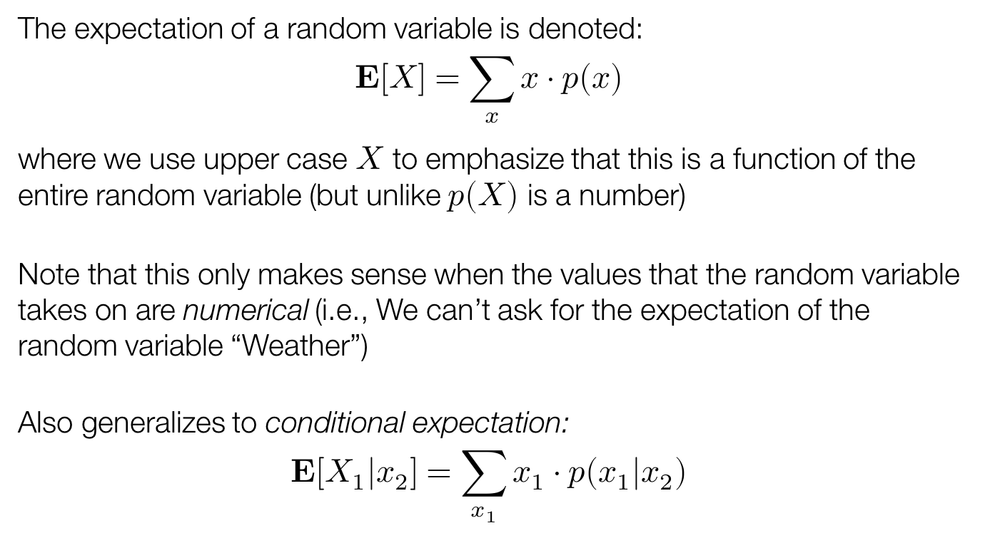
More general generative models
This notion of a “sequential story” (generative model) is extremely powerful for describing very general distributions
Naive Bayes:
$$Y∼Bernoulli\left(φ\right) \\ X_{i}|Y=y∼Categorical\left(φ_{y}^{\left(i\right)}\right)$$
Gaussian mixture model:
$$Z∼Categorical\left(φ\right) \\ X|Z=z∼𝒩\left(μ_{z}, Σ_{z}\right)$$

Slide 57
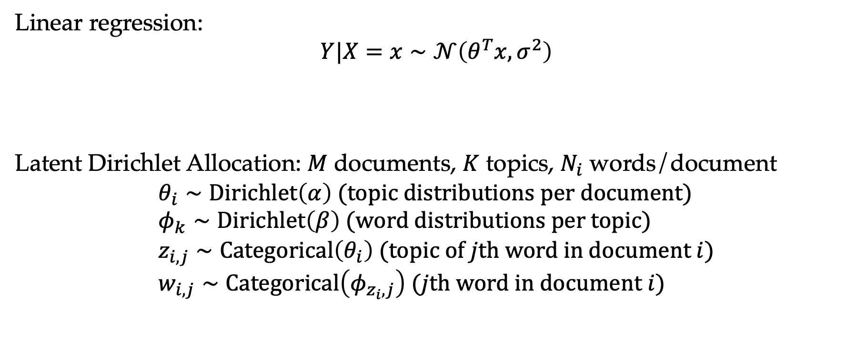
More general generative models
Linear regression:
$$Y|X=x∼𝒩\left(θ^{T}x, σ^{2}\right)$$
Latent Dirichlet Allocation: $M$ documents, $K$ topics, $N_{i}$ words/document
$$θ_{i}∼Dirichlet\left(α\right) (topic distributions per document) \\ φ_{k}∼Dirichlet\left(β\right) (word distributions per topic) \\ z_{i,j}∼Categorical\left(θ_{i}\right) (topic of jth word in document i) \\ w_{i,j}∼Categorical\left(φ_{z_{i},j}\right) (jth word in document i)$$

